Slide 1
Low-Fi Prototype & Usability Testing
Studio: Arts & Culture
Taylor Lallas, Krishnan Nair, Baker Sharp, Ayelet Drazen

Slide 2
OVERVIEW
01
02
03
EXPLORING DESIGN IDEAS
THE LOW-FI PROTOTYPE
USABILITY TESTING & ANALYSIS

Slide 3
MISSION STATEMENT
Enabling cultural immersion through personal stories
VALUE PROP
Illuminate your world
Notes:
Our mission statement served as a guiding light when exploring potential interfaces & eventually narrowing down our Low-fi prototype ideas. (ADD VALUE PROP?)

Slide 4
01
EXPLORING DESIGN IDEAS

Slide 5
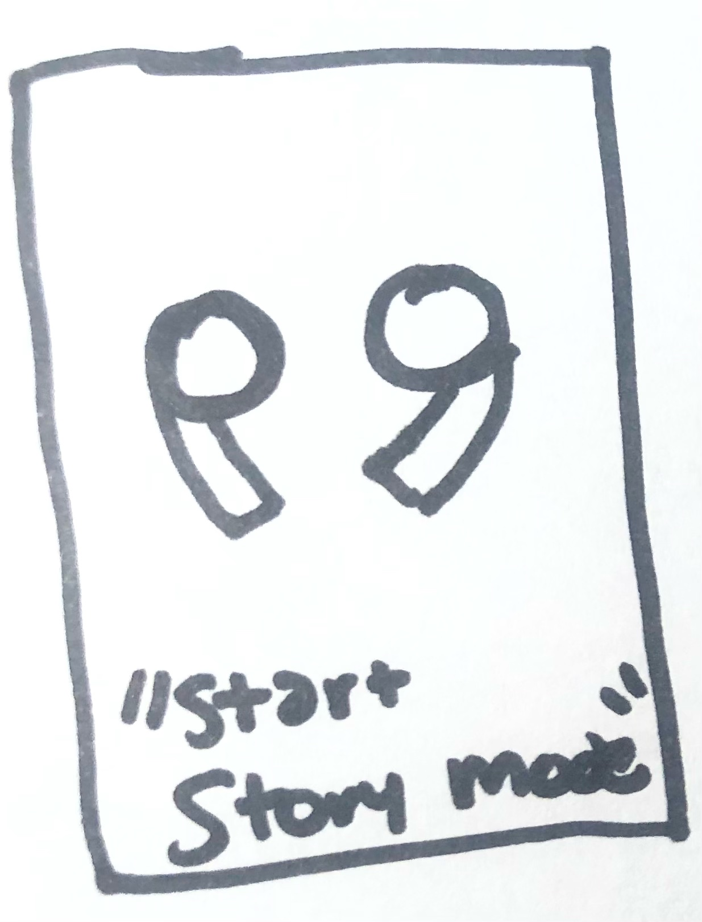
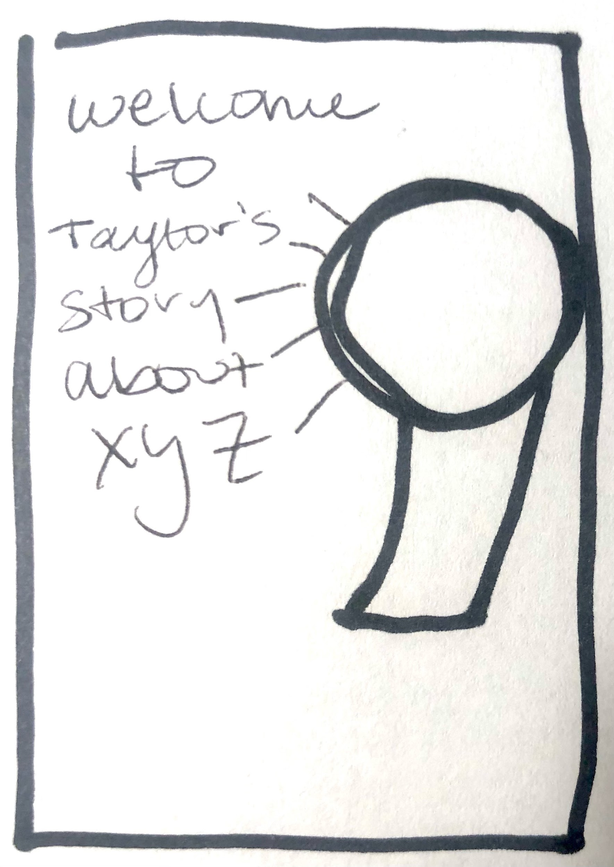
WEARABLE

Slide 6
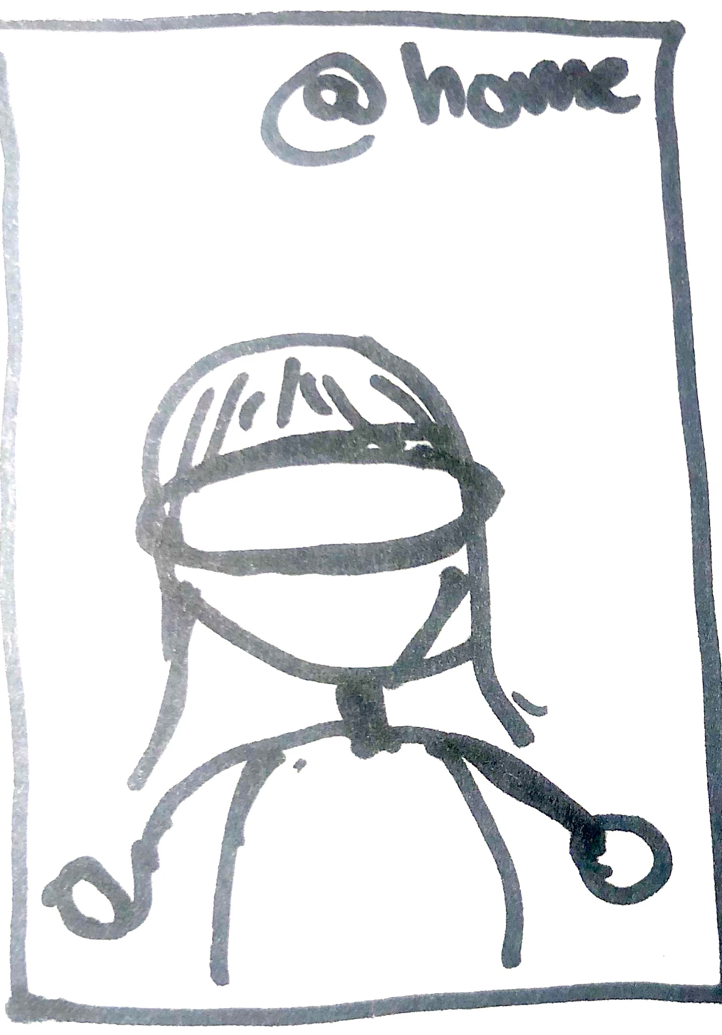
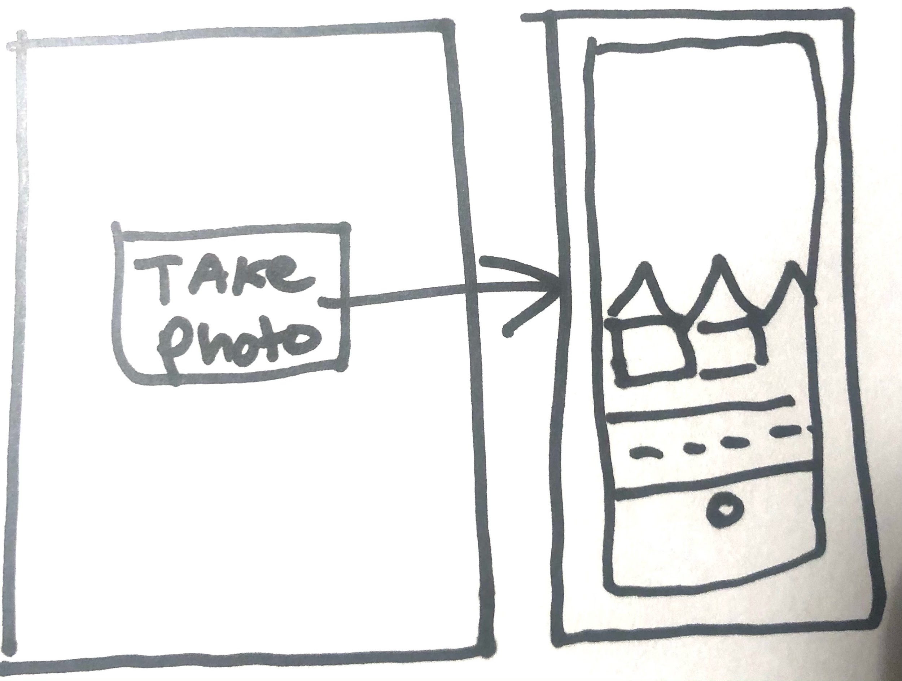
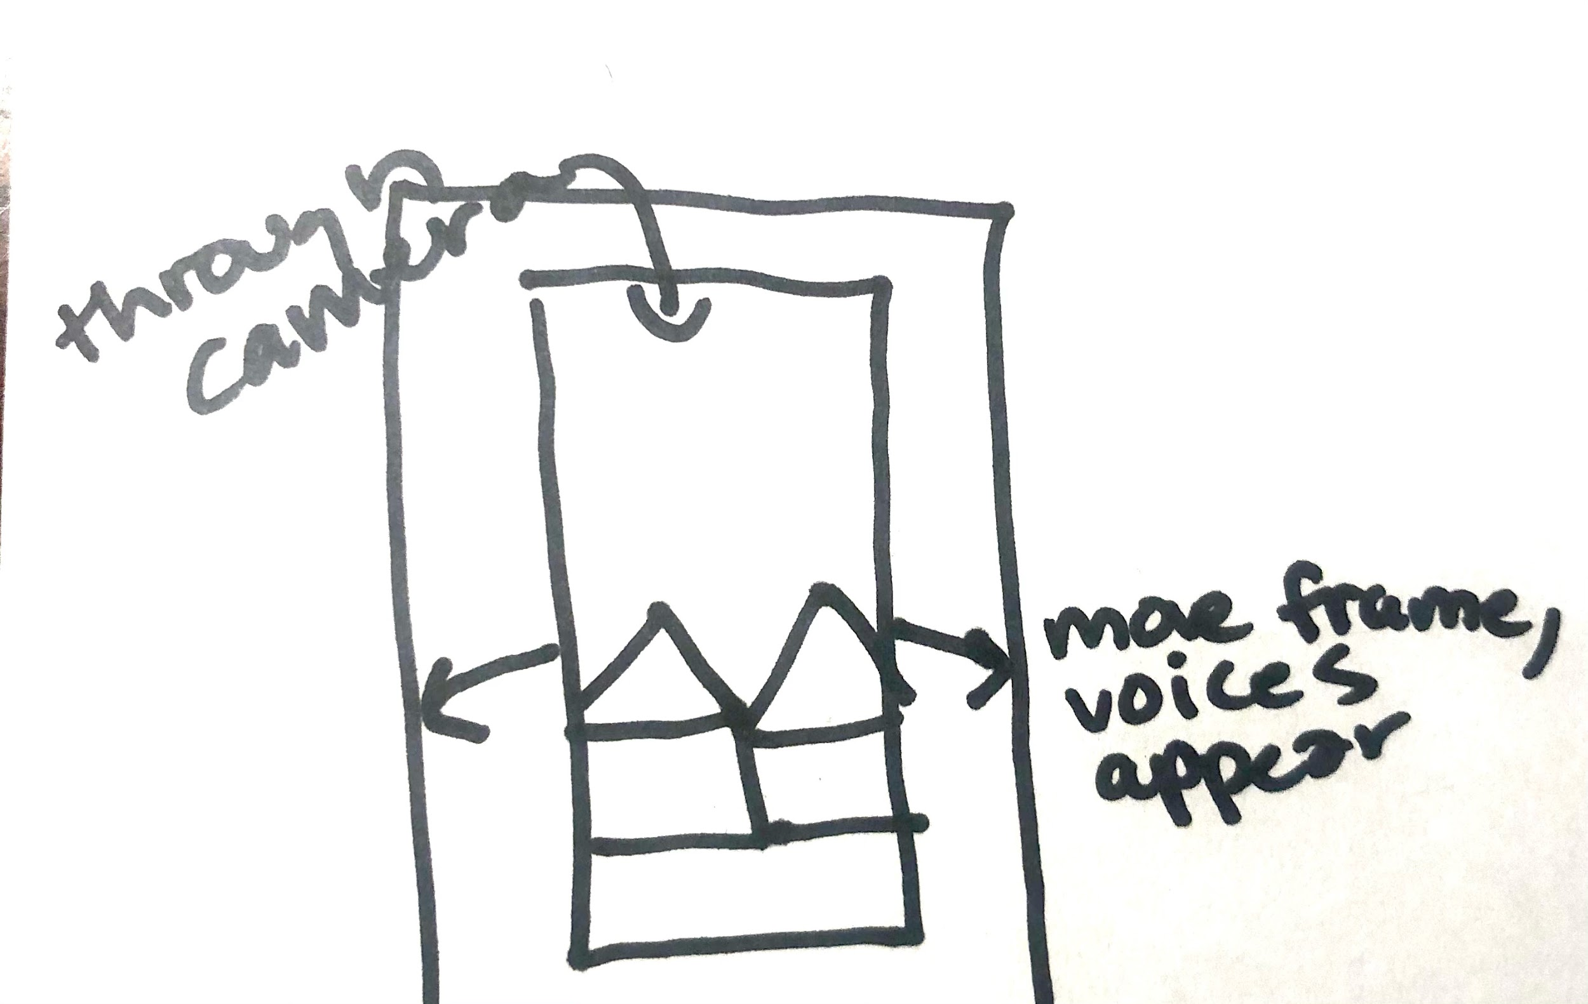
AR/VR

Slide 7
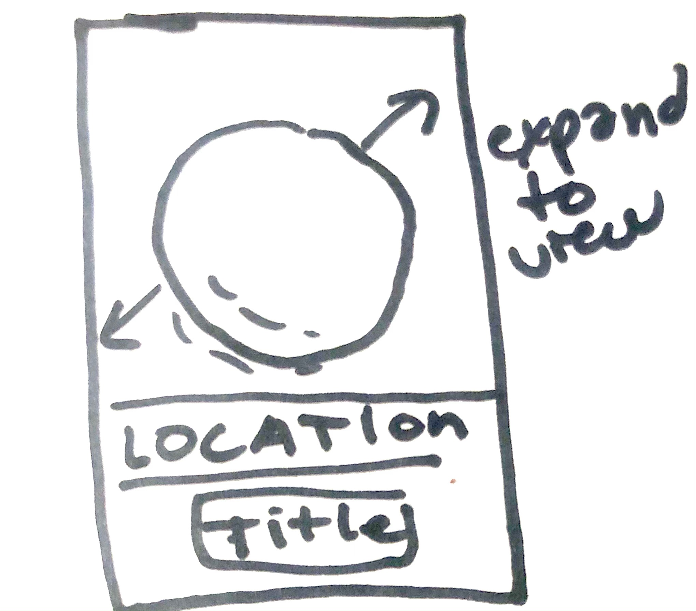
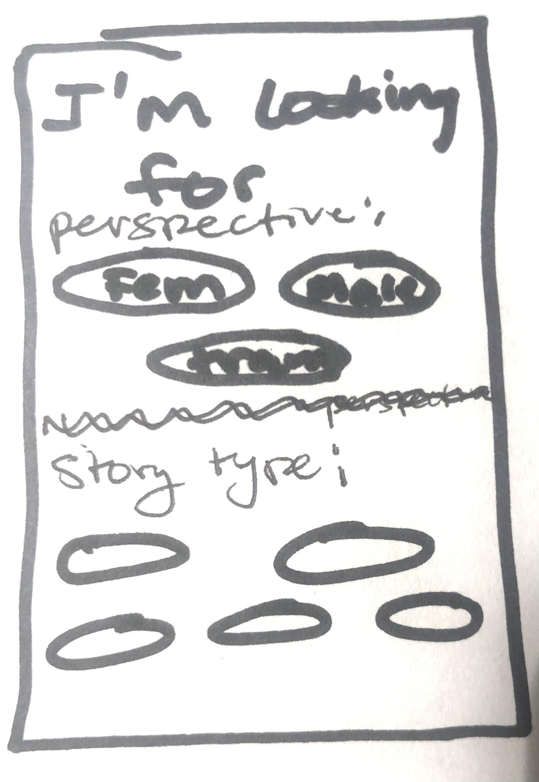
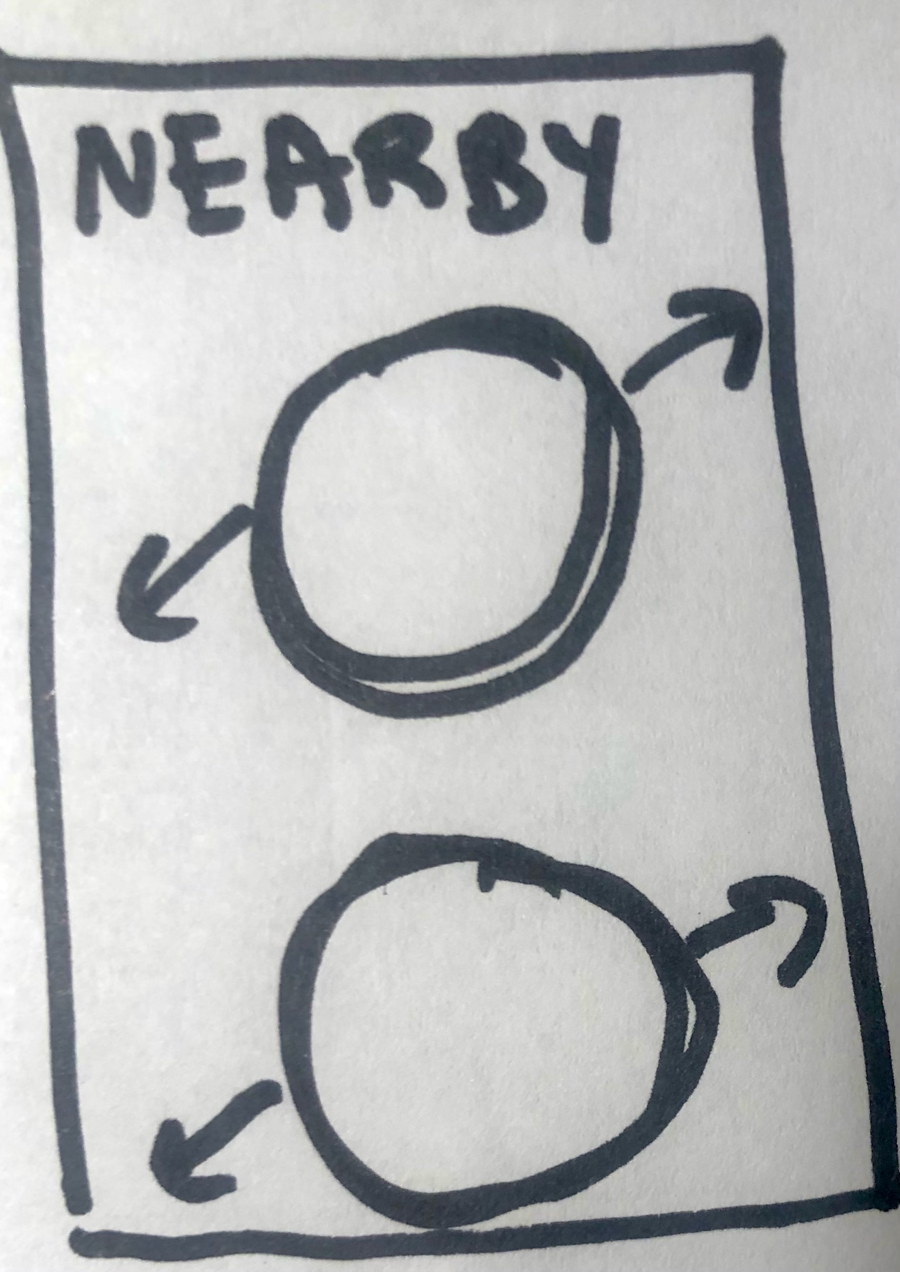
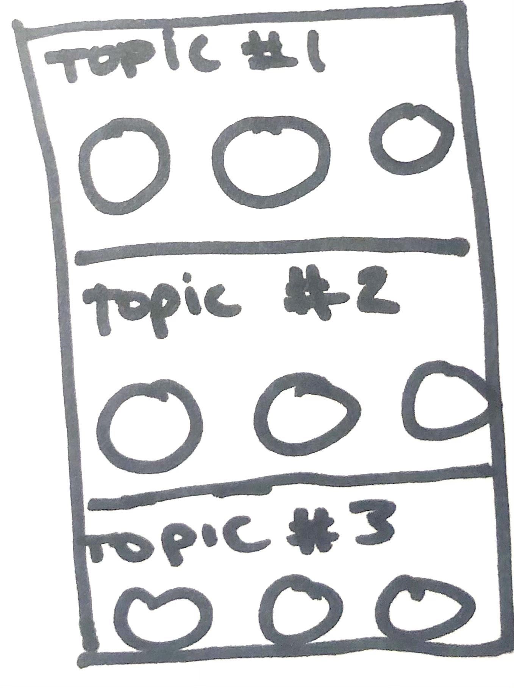
STORY TINDER

Slide 8
MAPS
User is shown a map of their current location
User can see the top (i.e. “most popular”) stories near them
User gets a customized map with the stories they select and a path between these stories
User can select radius and then spin “wheel of stories” to get a random story within selected radius
User can learn more about the story and navigate to story

Slide 9
VOICE
The main interface with which a user interacts is by listening to the story
A user can record audio reactions (essentially voice memos) in response to the story they are listening to
User gets a summary of that day’s “conversation”
User is prompted to listen to audio narration
Three simple steps to listen to a story!

Slide 10
NEWS FEED
User given a menu of different options of ways to read the news
A curated list of stories (a “digest”) is created for the user based on their recent reads
Users can also browse by topic similar to how one can browse a newspaper by section
The top stories of the day features stories from all around the world
Each story can be read just like a news article

Slide 11
INTERFACE SELECTION
Map-based Exploration
Wearables
Newsfeed
Voice Controlled
AR/VR
Story Swiper

Slide 12
INTERFACE SELECTION
Map-based Exploration
Wearables
Newsfeed
Voice Controlled
AR/VR
Story Swiper

Slide 13
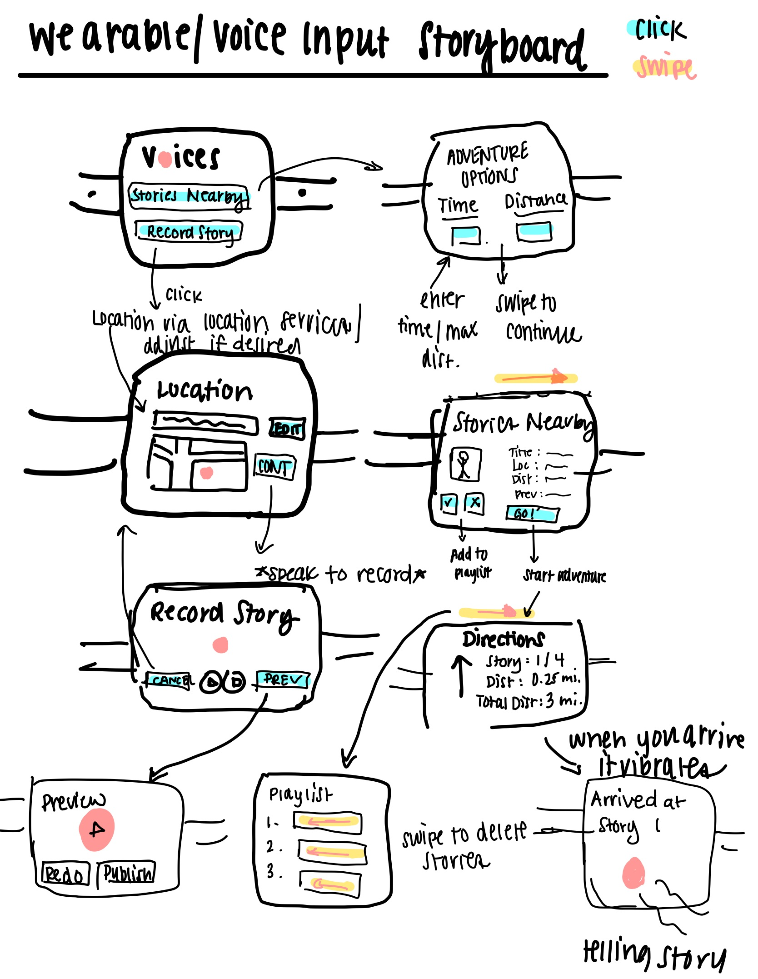
Wearable Storyboard
headphones
required!

Slide 14
WEARABLES: PROS AND CONS
Novel user experience
Minimalist interface
Voice Input = No text input
Phone down, eyes up
Encourages on-site exploration
Voice input may struggle to understand other languages
Only audio stories
Local stories only
Smart watch, headphones required → accessibility issue
Notes:
Rephrase visually see distance
Easily appreciate distance
Wearables requires current location; map gets at our goal of sharing culture esp if people can’t travel
Also an accessibility issues

Slide 15
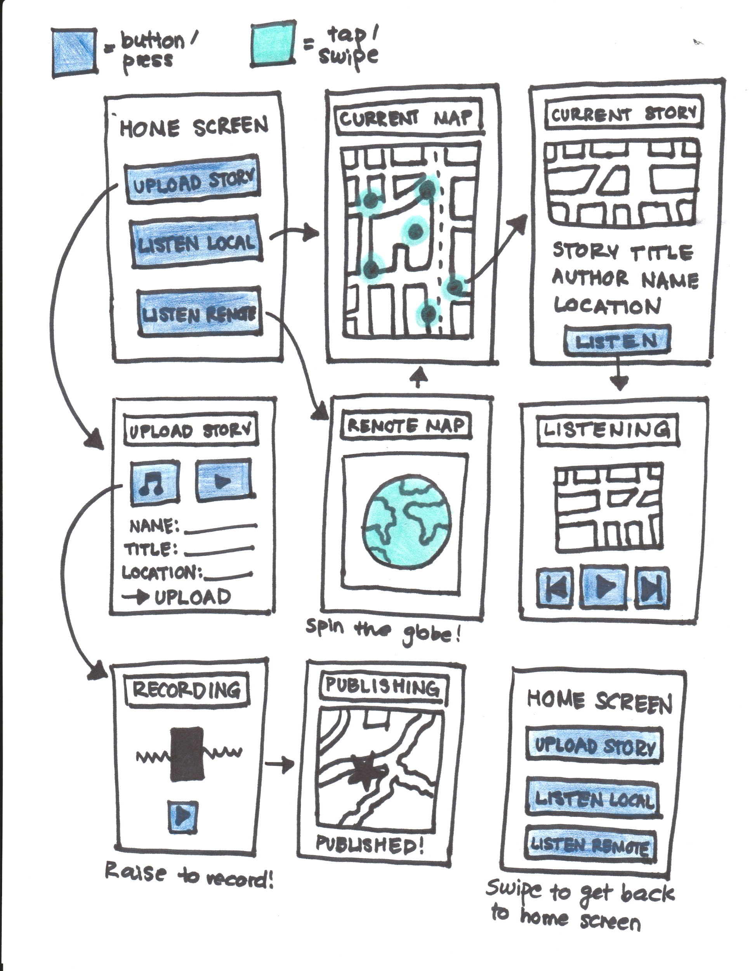
Map-Based Storyboard

Slide 16
MAPS: PROS AND CONS
Interact with stories everywhere
Clear story → location relationship
Familiar UI (map)
More story formats compatible
Financial accessibility
Challenging for visually impaired users
Less active engagement than AR/wearable format
Notes:
Rephrase visually see distance
Easily appreciate distance
Wearables requires current location; map gets at our goal of sharing culture esp if people can’t travel

Slide 17
SELECTED INTERFACE:
MAP-BASED EXPLORATION
Notes:
The decision to go with the map based interface truly comes down to the goal/mission of this project. We want people to be able to interact with other cultures regardless of distance. The map based interface allowed for a greater range of stories to be accessed. Similarly, accessibility is increased with a phone interface not only through the number of compatible story formats for a phone, but also the fact that more people have phones compared to smart watches. Furthermore, editing/recording your story is much easier on a phone than a watch. Finally, the interactive/explorative aspect of the wearables interface can be implemented in the phone, but would have to be more strategic in order to provide safety and ease of use.

Slide 18
02
THE LOW-FI PROTOTYPE

Slide 19
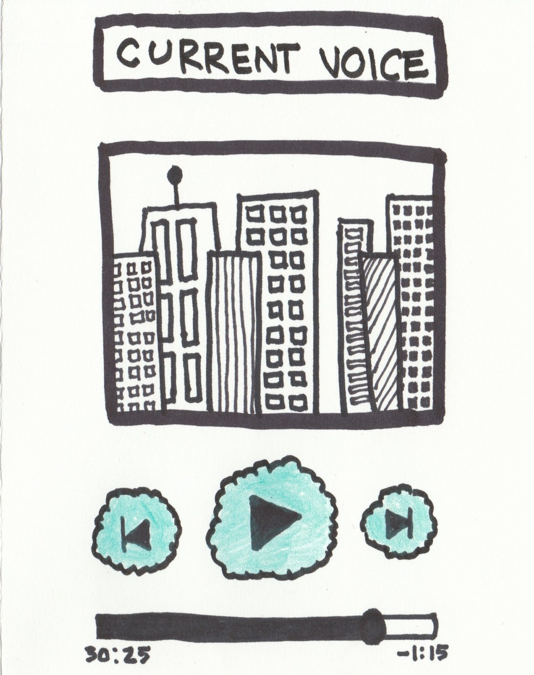
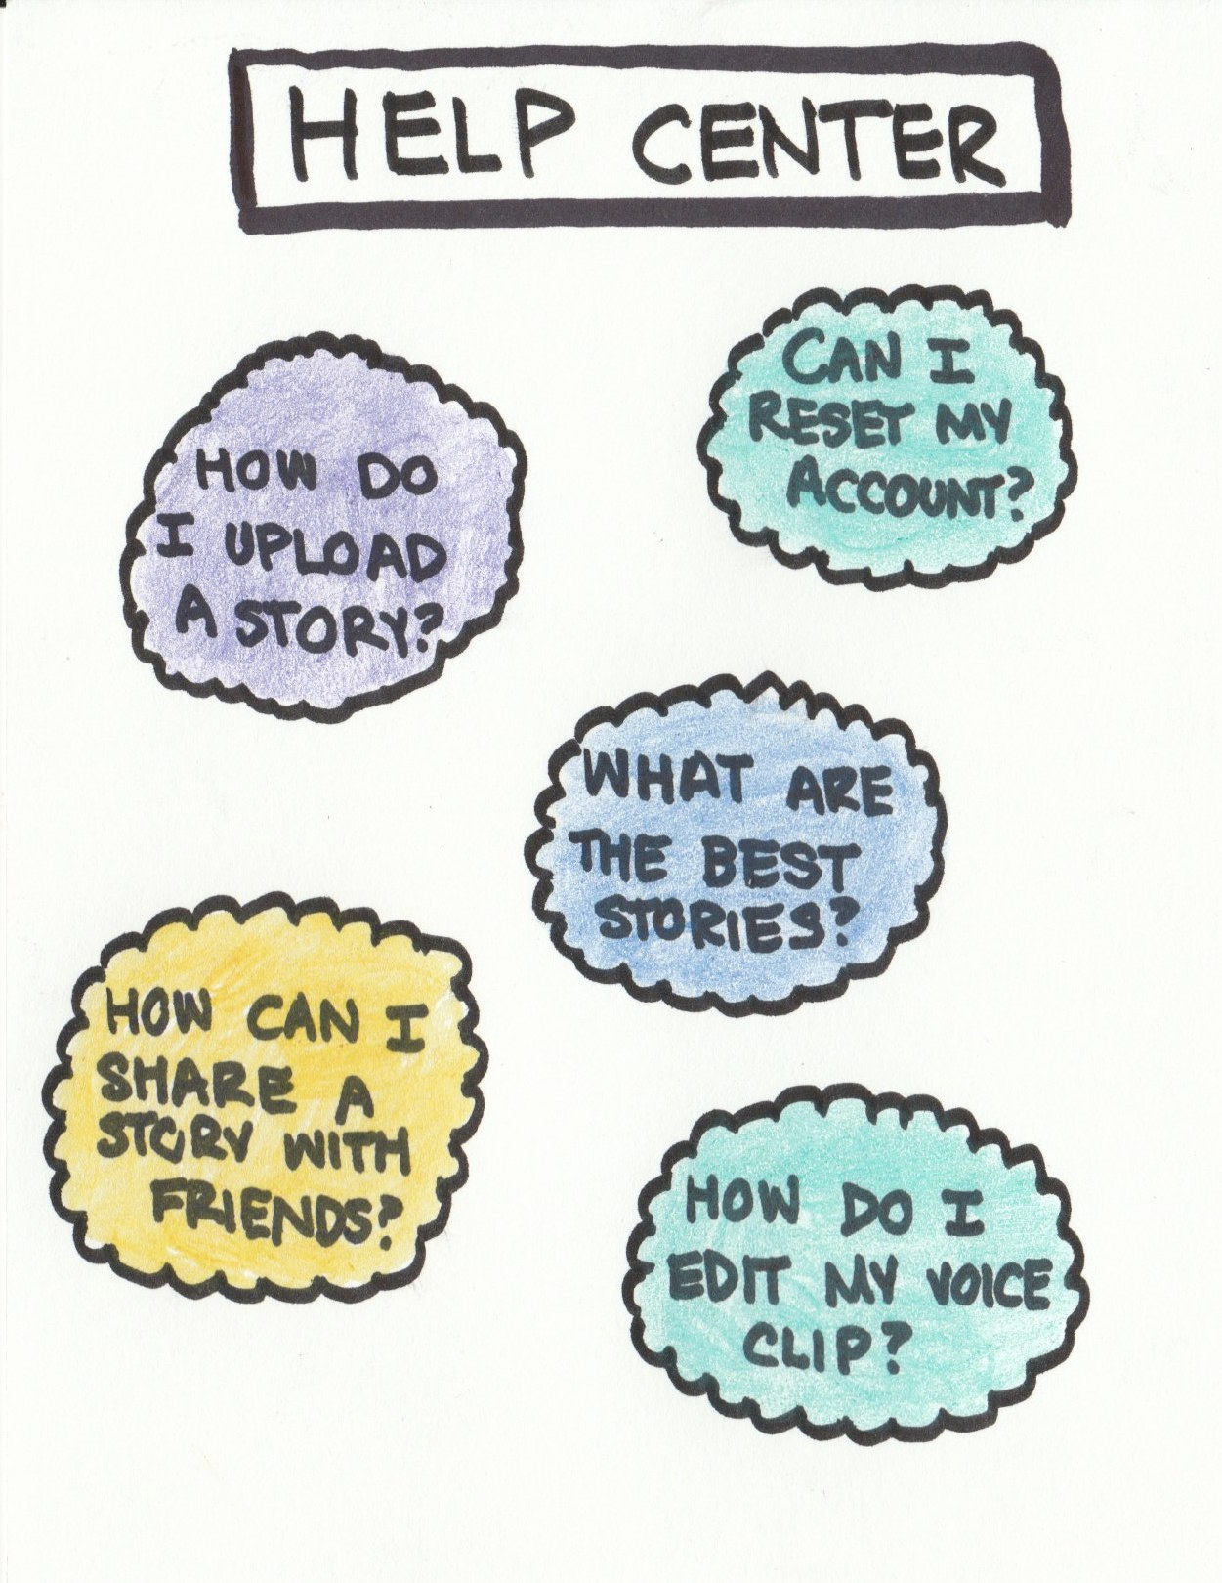
PROTOTYPE STRUCTURE
Notes:
Insert image of prototype pages relevant to listening to a story
Focus on simplicity
Primarily pushing buttons/minimal text input
Phone interface

Slide 20
SIMPLE TASK
Find and Listen to a Story
Notes:
Simple task was originally just listen to a story. However, this went hand in hand with finding a story and we assumed that most people would listen to the story even if we just instructed them to find it. Thus we combined them as our simple task as it is the most intuitive out of all three and most streamlined in our opinion.

Slide 21
FIND AND LISTEN TO A STORY
Notes:
Insert image of prototype pages relevant to finding a story

Slide 22
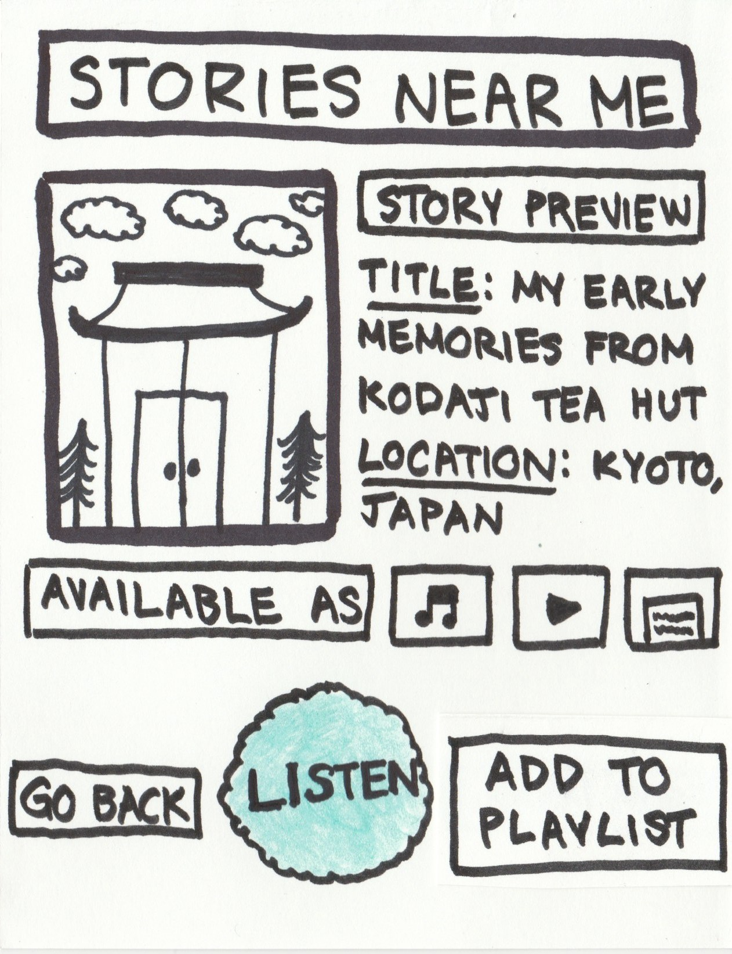
FIND AND LISTEN TO A STORY
Notes:
Insert image of prototype pages relevant to finding a story

Slide 23
MODERATE TASK
Add to a playlist
Notes:
HMW identify people who would inspire him
HMW make the people around him more inspiring/find inspiration in everyone*
HMW make uncomfortable situations growth opportunities **
HMW make engagement between people who seem different meaningful
HMW transform diversity in organizations without first needing people to engage with inspirers
HMW connect inspirational people to inspiration seekers
HMW make artistic/other media as inspirational as human engagement *
HMW create adventures for people to learn about each others cultures
HMW make it easy for Mitch to engage with other culture
HMW make it easy for minorities to introduce their culture people like Mitch
HMW facilitate a feeling of closeness among strangers immediately *
HMW make diversity the norm in all companies
HMW get people engaged w/ diversity without putting the onus on the “diverse” people
HMW increase the perceived value of other cultures
HMW remove apathy for homogeneity
HMW encourage companies to value cultural diversity
HMW make work a safe space to share and learn about cultural diversity
HMW bring show and tell to workspaces
HMW reward employees for valuing diversity
HMW show the reward of cultural diversity to employees. *
HMW introduce people to people who are like them from other cultures
HMW empower people to make workplace diversity a priority
HMW “randomly” introduce two like-minded people from different cultures ***
HMW reduce the stigma of meeting people who are different from oneself
HMW make people more comfortable meeting people who are different from oneself
HMW make learning about another culture akin to learning from a friend *

Slide 24
ADD TO PLAYLIST
Notes:
Insert image of prototype pages relevant to finding a story

Slide 25
ADD TO PLAYLIST
Notes:
Insert image of prototype pages relevant to finding a story

Slide 26
COMPLEX TASK
Share a story
Notes:
HMW identify people who would inspire him
HMW make the people around him more inspiring/find inspiration in everyone*
HMW make uncomfortable situations growth opportunities **
HMW make engagement between people who seem different meaningful
HMW transform diversity in organizations without first needing people to engage with inspirers
HMW connect inspirational people to inspiration seekers
HMW make artistic/other media as inspirational as human engagement *
HMW create adventures for people to learn about each others cultures
HMW make it easy for Mitch to engage with other culture
HMW make it easy for minorities to introduce their culture people like Mitch
HMW facilitate a feeling of closeness among strangers immediately *
HMW make diversity the norm in all companies
HMW get people engaged w/ diversity without putting the onus on the “diverse” people
HMW increase the perceived value of other cultures
HMW remove apathy for homogeneity
HMW encourage companies to value cultural diversity
HMW make work a safe space to share and learn about cultural diversity
HMW bring show and tell to workspaces
HMW reward employees for valuing diversity
HMW show the reward of cultural diversity to employees. *
HMW introduce people to people who are like them from other cultures
HMW empower people to make workplace diversity a priority
HMW “randomly” introduce two like-minded people from different cultures ***
HMW reduce the stigma of meeting people who are different from oneself
HMW make people more comfortable meeting people who are different from oneself
HMW make learning about another culture akin to learning from a friend *

Slide 27
SHARE A STORY
Notes:
Insert image of prototype pages relevant to sharing a story

Slide 28
03
USABILITY TESTING & ANALYSIS

Slide 29
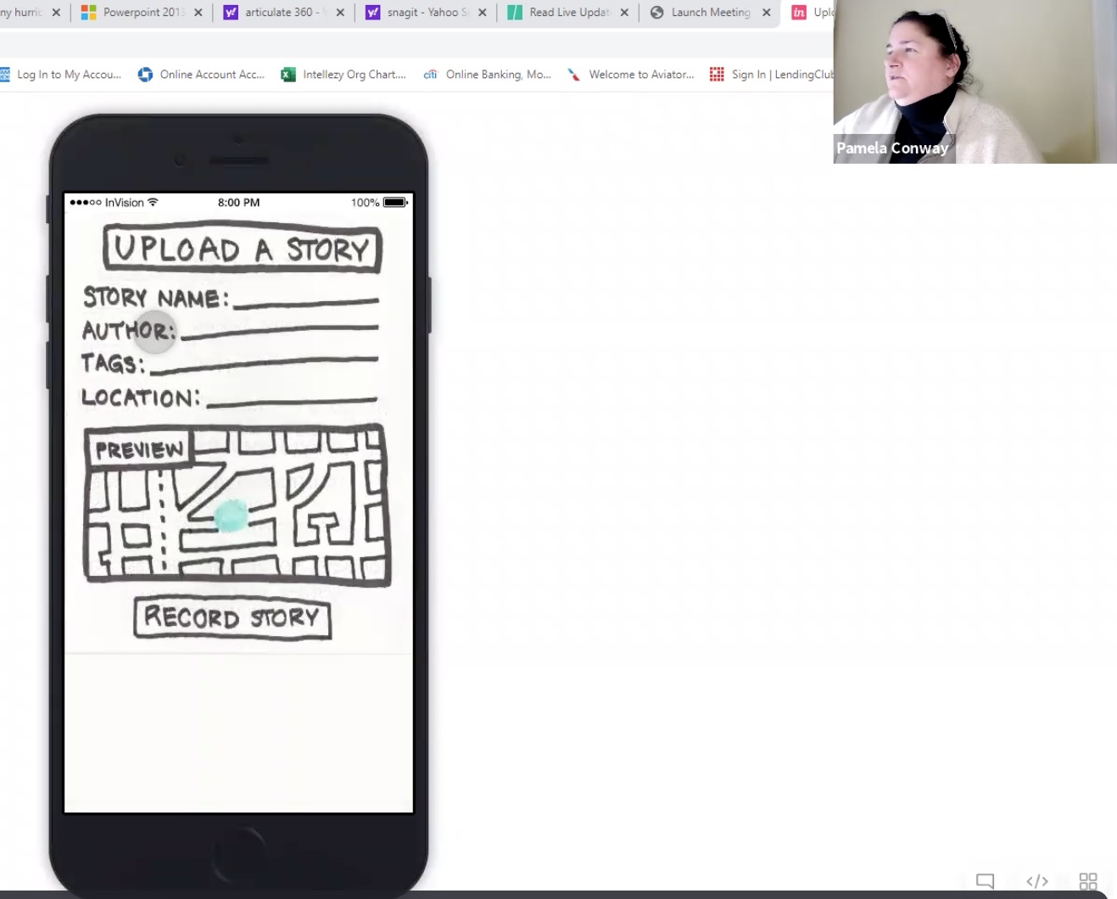
EXPERIMENTAL
METHOD
Zoom interview w/ participant sharing screen
Leveraged inVision
No compensation
Notes:
Participants on desktop couldnt hug laptop and some struggled to share phone screen. Thus some used the online browser with a phone simulator instead.

Slide 30
INTERVIEW BREAKDOWN
Participant gives feedback and commentary, note-taker documents
Facilitator asks follow-up questions based on feedback
Facilitator gives overview & inVision demo
Participant shares screen, completes tasks one by one
Notes:
All testing recorded via zoom
No compensation
Analyzing successes, errors/confusion, timing,

Slide 31
We selected participants eager to...
Learn about other cultures
Share their own stories & culture

Slide 32
PARTICIPANT OVERVIEW
25
23
20
35
50
20
UI Design /Marketer
Spanish Major @ Brown
Nursing Student @ PLU
Community Engagement Director
Tech and Learning Services
Film Student @ Chapman
Notes:
All participants were recruited via cold calling. No compensation was provided for the interview, but we did express an immense amount of gratitutde.

Slide 33
TESTING THE TASKS
Find and listen to a story nearby
Add a story from Japan to your playlist
Upload a story

Slide 34
PARTICIPANTS
-UI designer and marketing
-Grew up in California surrounded by other cultures
-Nursing student at PLU
-Uses clubs to share Hawaiian/Japanese culture

Slide 35
PARTICIPANTS
-Community Engagement Director
-From India, studied in London
-Old President of Indian Association of North Texas
Spanish major @ Brown
Very involved in Los Angeles Persian community

Slide 36
PARTICIPANTS
-Filmmaker, photographer and designer
-Current student at Chapman
-Shares stories via visual mediums
-Loves to travel
-Loves to visit historic sites/museums when traveling
-Avid listener of “NPR Storycorps”

Slide 37
RESULTS: TIMING
Find and listen to a story nearby
Add a story from Japan to your playlist
Upload a story

Slide 38
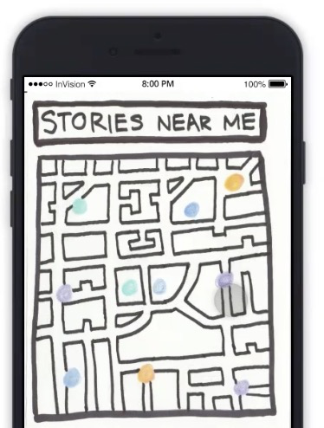
RESULTS: SUCCESSES
Finding and listening to stories nearby was simple
Liked having pictures associated with the story
Easy to understand
map UI
Loved the concept & simple UI
Notes:
Listening and finding stories nearby was easy
Enjoyed the simple design
People loved the concept!
Many people commented on the simplicity, with one person comparing it to Apple-esque apps

Slide 39
“The map is pretty cool because if I’m actually there or planning a day in the area, I could use it to map out my day”
Participant #6

Slide 40
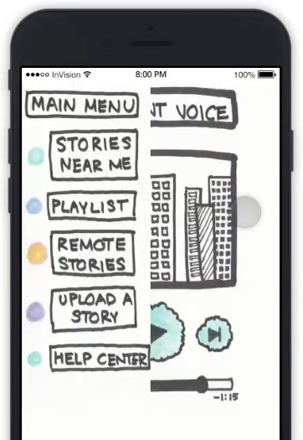
RESULTS: ERRORS
Navigation Mishaps
Side-swipe menu wasn’t intuitive/clear
No back button/back swipe functionality to go back one page

Slide 41
RESULTS: ERRORS
Confusing Labels
Misunderstanding “remote stories”
Went to “upload a story” when looking to add a story from Japan to playlist

Slide 42
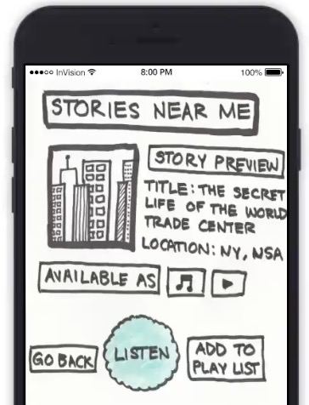
RESULTS: ERRORS
Confusing Colors & Icons
Do different colors on stories have meaning?
Okay, but where am I on the map?
Does this mean play music?

Slide 43
“ What’s different about this than Snapchat or Instagram stories? ”
Participant #2
Notes:
“That’s so cool! That’s so different. I just didn’t know…” In response to explanation

Slide 44
RESULTS: EXPRESSED WANTS
Concept Clarity
Confusion about voices vs stories
Misconstrued stories as similar to Snapchat & Instagram stories

Slide 45
RESULTS: EXPRESSED WANTS
Multimedia Storytelling
Photos taken by the authors
Concern for hearing-impaired, want transcribed stories

Slide 46
RESULTS: EXPRESSED WANTS
Story Organization
Desire for tagging/grouping stories by theme & ideas
Multiple voices may appear in same location → no way to switch/scroll between them
Wants to develop multiple playlists

Slide 47
RESULTS: EXPRESSED WANTS
Deep Connections by Design
Desire for social aspect (following friends or sharing stories w/ friends)
Desire to connect to the story via topic or through actual author

Slide 48
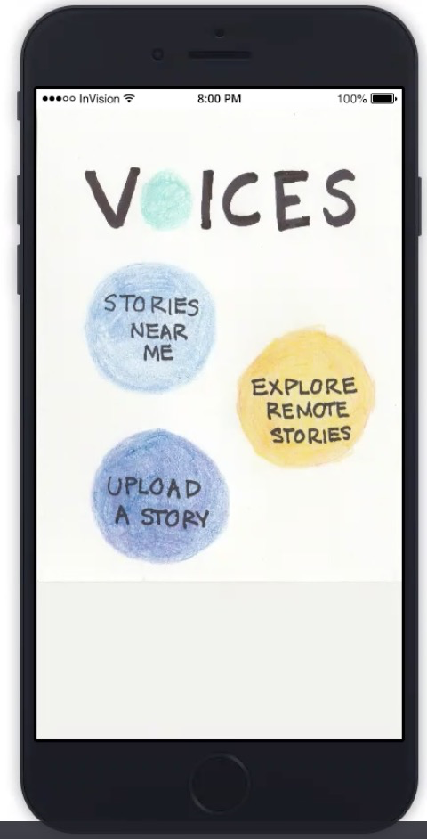
UI CHANGE #1: NAVIGATION
Remove basic home screen
Persistent nav bar for fast transitions
Back button or swipe

Slide 49
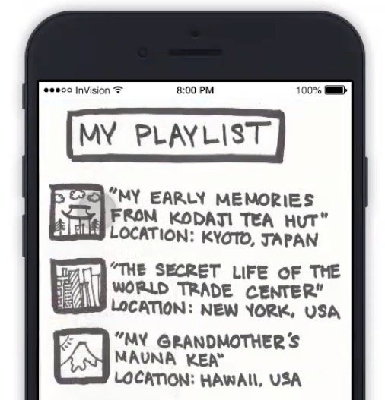
UI CHANGE #2: PLAYLIST REVAMP
Many, customizable playlists
Suggested voices
Map view for playlists

Slide 50
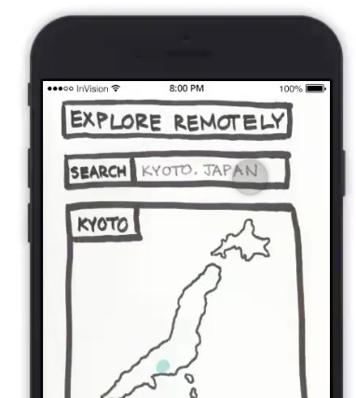
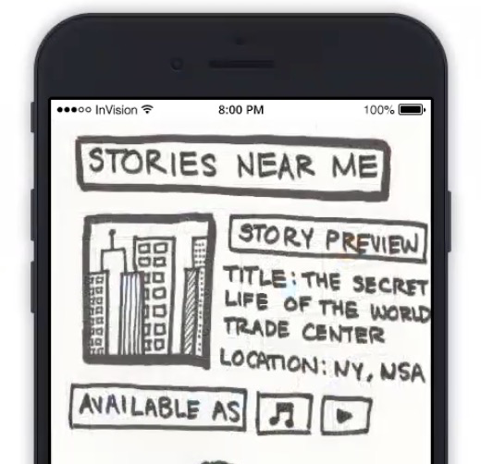
UI CHANGE #3: CLARIFYING ADJUSTMENTS
Stories @ World Trade Center
Specify location in preview
Rename “remote stories”
through
stories
at a location
“Explore Everywhere”?

Slide 51
SUMMARY

Slide 52
IN SUMMARY, we will need to...
Ensure concept clarity while keeping the UI simple
Be more intentional about the use of colors & labels
Make the experience more dynamic through multimedia and personalization

