Slide 1
PROTOTYPING
Taylor Lallas, Krishnan Nair, Baker Sharp, Ayelet Drazen
Studio: Arts & Culture

Slide 2
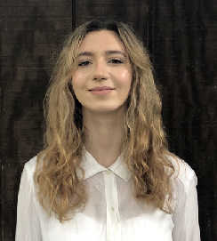
OUR TEAM
Taylor Lallas
B.A. Economics
M.S. Computer Science
Krishnan Nair
B.S. Computer Science
Baker Sharp
B.S.. Computer Science
Ayelet Drazen
B.A. Political Science
M.S. Computer Science
Problem domain: exploring how people dive into and share their culture

Slide 3
REFINING OUR FOCUS
Old Domain: exploring the relationship between one’s personal network and artistic tastes
New Domain: exploring how people dive into other cultures and share their own culture
Notes:
I cant make the arrow thicker for some reason???
Recommend skipping if he explains it.

Slide 4
OVERVIEW
01
MORE NEEDFINDING
02
POV AND HMW
03
EXPERIENCE PROTOTYPE
04
SOLUTION AND SUMMARY

Slide 5
INITIAL POV
We met Kawena, a Hawaiian-Japanese hula dancer who is involved with the indigenous community.
We were amazed to realize she struggled to maintain engagement with her audience when discussing the historical context of her performance.
It would be game-changing to make historical context more desirable to her audiences.

Slide 6
RECRUITING PARTICIPANTS
◾ Cold Calling
◾ No Compensation - but we appreciate them ❤️
◾ Chosen based on relationship with cultural arts
◾ Sought out a diverse panel (race, age, interests, etc)
Notes:
I cant make the arrow thicker for some reason???

Slide 7
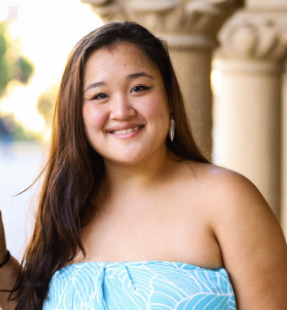
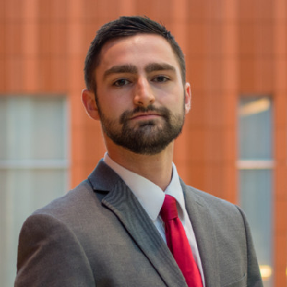
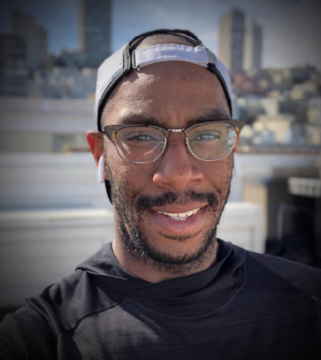
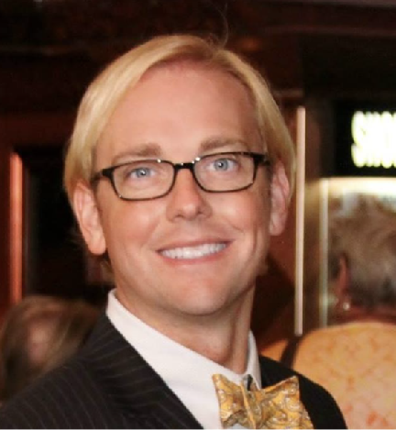
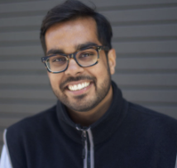
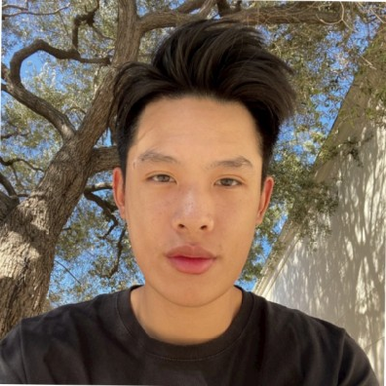
NEEDFINDING 1
OUR INTERVIEWEES
NEEDFINDING 2
PROTOTYPING
Kawena
Justin
Michelle
Stone
Nadin
Andreley
Wesley
Gus
Polina
Junryl
Marisa
Mitch
Sierra
Anil
Asante
Wilson
Marco
Jerry
Karen

Slide 8
OUR INTERVIEWEES
NEEDFINDING 2
Stone
Nadin
Mitch
Sierra
Notes:
CUT THIS SLIDE

Slide 9
01
NEEDFINDING PART 2

Slide 10
NADIN
◾ Enjoys spices and flavors and experiencing new cultures
◾ Has a deep appreciation for theater
User Type:
Notes:
Reminder that user types are at bottom

Slide 11
NADIN
Tension: wants to be around people during performances but finds “they make it about themselves.”
“The umami of a performance is the context...who are you with?”
User Type:

Slide 12
MITCH
◾ Avid traveller
◾ Lover of performing arts
◾ Healthcare lawyer
◾ Louisiana native and Mardi Gras aficionado
User Type:

Slide 13
MITCH
Surprise: as a tourist, he would try to be more like a local
“Open up to the pleasures of living like a local”
“They will tell you stories...it’s like a world you couldn’t even conceive”
User Type:

Slide 14
STONE
◾ Economics and Arabic student at University of Michigan
◾ Spends summers in the Middle East
◾ Lover of sports (wrestling)
User Type:

Slide 15
STONE
“There’s an important distinction between interacting with employees in tourism when in they’re in their work environment compared to a casual environment.”
User Type:

Slide 16
SIERRA
◾ Stanford student from Utah
◾ Lover of Latin culture
◾ Working in Mexico City
◾ Mariachi Performer
User Type:

Slide 17
SIERRA
Tension: Wants to ask, but she thinks “[she] will sound annoying and it may bother whoever she’s asking”
Feels like people see mariachi “as a joke… it’s almost like a caricature of Mexican culture”
User Type:

Slide 18
02
POV AND HMW

Slide 19
KAWENA
MARISA

Slide 20
POV # 1
We met Kawena, a Hawaiian-Japanese hula dancer who is involved with the indigenous community, and Marisa, a Filipino-Chinese competitive hula dancer.
Notes:
HMW change the stereotypes of certain cultures to be more positive
HMW make cultural context desirable*
HMW make cultural context rewarding ****
HMW have other cultures fight against stereotyping of other cultures
HMW generate our own stereotypes
HMW make a CrashCourse for cultural context **
HMW show the harm of negative stereotypes/exoticization/sexualization
HMW change how audience members interact with cultural performers ***
HMW incorporate non-performers to educate during performances
HMW make cultural context feel less like school *
HMW refocus the beauty that others see in cultural performances *
HMW make performances seem less sexual
HMW make viewers less sexually aroused by performers
HMW we make performances more understandable without a history lesson *
HMW make criticisms less apparent
HMW redirect judgements into admiration
HMW understand where stereotypes rise from
HMW we make Kawena more comfortable performing in front of people she doesn’t know?
HMW ensure that the observers don’t sexualize performers?
HMW teach audiences about the performance they are about to watch? *
HMW see what the audience thinks about a performance?
HMW make cultural context a prerequisite? *
HMW use context to enhance performances? ***
HMW interweave performances and cultural context?
HMW create safe performance spaces?
HMW teach others who are very different from us about our culture while maintaining boundaries
HMW make explaining one’s culture to others less burdensome**

Slide 21
POV # 1
We met Kawena, a Hawaiian-Japanese hula dancer who is involved with the indigenous community, and Marisa, a Filipino-Chinese competitive hula dancer.
We were amazed to realize they felt uncomfortable during some performances because they could be misinterpreted and exoticized by audience members.
Notes:
HMW change the stereotypes of certain cultures to be more positive
HMW make cultural context desirable*
HMW make cultural context rewarding ****
HMW have other cultures fight against stereotyping of other cultures
HMW generate our own stereotypes
HMW make a CrashCourse for cultural context **
HMW show the harm of negative stereotypes/exoticization/sexualization
HMW change how audience members interact with cultural performers ***
HMW incorporate non-performers to educate during performances
HMW make cultural context feel less like school *
HMW refocus the beauty that others see in cultural performances *
HMW make performances seem less sexual
HMW make viewers less sexually aroused by performers
HMW we make performances more understandable without a history lesson *
HMW make criticisms less apparent
HMW redirect judgements into admiration
HMW understand where stereotypes rise from
HMW we make Kawena more comfortable performing in front of people she doesn’t know?
HMW ensure that the observers don’t sexualize performers?
HMW teach audiences about the performance they are about to watch? *
HMW see what the audience thinks about a performance?
HMW make cultural context a prerequisite? *
HMW use context to enhance performances? ***
HMW interweave performances and cultural context?
HMW create safe performance spaces?
HMW teach others who are very different from us about our culture while maintaining boundaries
HMW make explaining one’s culture to others less burdensome**

Slide 22
POV # 1
We met Kawena, a Hawaiian-Japanese hula dancer who is involved with the indigenous community, and Marisa, a Filipino-Chinese competitive hula dancer
We were amazed to realize they felt uncomfortable during some performances because they could be misinterpreted and exoticized by audience members.
It would be game-changing to help their audiences gain the culture context of the performance to fully understand the beauty of the performance.
Notes:
HMW change the stereotypes of certain cultures to be more positive
HMW make cultural context desirable*
HMW make cultural context rewarding ****
HMW have other cultures fight against stereotyping of other cultures
HMW generate our own stereotypes
HMW make a CrashCourse for cultural context **
HMW show the harm of negative stereotypes/exoticization/sexualization
HMW change how audience members interact with cultural performers ***
HMW incorporate non-performers to educate during performances
HMW make cultural context feel less like school *
HMW refocus the beauty that others see in cultural performances *
HMW make performances seem less sexual
HMW make viewers less sexually aroused by performers
HMW we make performances more understandable without a history lesson *
HMW make criticisms less apparent
HMW redirect judgements into admiration
HMW understand where stereotypes rise from
HMW we make Kawena more comfortable performing in front of people she doesn’t know?
HMW ensure that the observers don’t sexualize performers?
HMW teach audiences about the performance they are about to watch? *
HMW see what the audience thinks about a performance?
HMW make cultural context a prerequisite? *
HMW use context to enhance performances? ***
HMW interweave performances and cultural context?
HMW create safe performance spaces?
HMW teach others who are very different from us about our culture while maintaining boundaries
HMW make explaining one’s culture to others less burdensome**

Slide 23
MITCH

Slide 24
POV # 2
We met Mitch, a healthcare lawyer based in Dallas, Texas who was nervous to be randomly paired with a roommate at a retreat because of his sexual orientation.
Notes:
HMW identify people who would inspire him
HMW make the people around him more inspiring/find inspiration in everyone*
HMW make uncomfortable situations growth opportunities **
HMW make engagement between people who seem different meaningful
HMW transform diversity in organizations without first needing people to engage with inspirers
HMW connect inspirational people to inspiration seekers
HMW make artistic/other media as inspirational as human engagement *
HMW create adventures for people to learn about each others cultures
HMW make it easy for Mitch to engage with other culture
HMW make it easy for minorities to introduce their culture people like Mitch
HMW facilitate a feeling of closeness among strangers immediately *
HMW make diversity the norm in all companies
HMW get people engaged w/ diversity without putting the onus on the “diverse” people
HMW increase the perceived value of other cultures
HMW remove apathy for homogeneity
HMW encourage companies to value cultural diversity
HMW make work a safe space to share and learn about cultural diversity
HMW bring show and tell to workspaces
HMW reward employees for valuing diversity
HMW show the reward of cultural diversity to employees. *
HMW introduce people to people who are like them from other cultures
HMW empower people to make workplace diversity a priority
HMW “randomly” introduce two like-minded people from different cultures ***
HMW reduce the stigma of meeting people who are different from oneself
HMW make people more comfortable meeting people who are different from oneself
HMW make learning about another culture akin to learning from a friend *

Slide 25
POV # 2
We met Mitch, a healthcare lawyer based in Dallas, Texas who was nervous to be randomly paired with a roommate at a retreat because of his sexual orientation.
We were amazed to realize that after Mitch immersed himself in his roommates culture during the retreat, he took the initiative to address diversity issues at his company.
Notes:
HMW identify people who would inspire him
HMW make the people around him more inspiring/find inspiration in everyone*
HMW make uncomfortable situations growth opportunities **
HMW make engagement between people who seem different meaningful
HMW transform diversity in organizations without first needing people to engage with inspirers
HMW connect inspirational people to inspiration seekers
HMW make artistic/other media as inspirational as human engagement *
HMW create adventures for people to learn about each others cultures
HMW make it easy for Mitch to engage with other culture
HMW make it easy for minorities to introduce their culture people like Mitch
HMW facilitate a feeling of closeness among strangers immediately *
HMW make diversity the norm in all companies
HMW get people engaged w/ diversity without putting the onus on the “diverse” people
HMW increase the perceived value of other cultures
HMW remove apathy for homogeneity
HMW encourage companies to value cultural diversity
HMW make work a safe space to share and learn about cultural diversity
HMW bring show and tell to workspaces
HMW reward employees for valuing diversity
HMW show the reward of cultural diversity to employees. *
HMW introduce people to people who are like them from other cultures
HMW empower people to make workplace diversity a priority
HMW “randomly” introduce two like-minded people from different cultures ***
HMW reduce the stigma of meeting people who are different from oneself
HMW make people more comfortable meeting people who are different from oneself
HMW make learning about another culture akin to learning from a friend *

Slide 26
POV # 2
We met Mitch, a healthcare lawyer based in Dallas, Texas who was nervous to be randomly paired with a roommate at a retreat because of his sexual orientation.
We were amazed to realize that after Mitch immersed himself in his roommates culture during the retreat, he took the initiative to address diversity issues at his company.
It would be game-changing to allow people like Mitch to engage with people who inspire them to pursue positive endeavors with regards to diversity.
Notes:
HMW identify people who would inspire him
HMW make the people around him more inspiring/find inspiration in everyone*
HMW make uncomfortable situations growth opportunities **
HMW make engagement between people who seem different meaningful
HMW transform diversity in organizations without first needing people to engage with inspirers
HMW connect inspirational people to inspiration seekers
HMW make artistic/other media as inspirational as human engagement *
HMW create adventures for people to learn about each others cultures
HMW make it easy for Mitch to engage with other culture
HMW make it easy for minorities to introduce their culture people like Mitch
HMW facilitate a feeling of closeness among strangers immediately *
HMW make diversity the norm in all companies
HMW get people engaged w/ diversity without putting the onus on the “diverse” people
HMW increase the perceived value of other cultures
HMW remove apathy for homogeneity
HMW encourage companies to value cultural diversity
HMW make work a safe space to share and learn about cultural diversity
HMW bring show and tell to workspaces
HMW reward employees for valuing diversity
HMW show the reward of cultural diversity to employees. *
HMW introduce people to people who are like them from other cultures
HMW empower people to make workplace diversity a priority
HMW “randomly” introduce two like-minded people from different cultures ***
HMW reduce the stigma of meeting people who are different from oneself
HMW make people more comfortable meeting people who are different from oneself
HMW make learning about another culture akin to learning from a friend *

Slide 27
SIERRA

Slide 28
POV # 3
We met Sierra, a white Stanford student from Utah who is working in Mexico City on her gap year.
Notes:
HMW make sharing info thrilling rather than burdensome
HMW make asking questions less intrusive ***
HMW improve the available resources
HMW make the resources more credible
HMW remove the need to ask questions?
HMW cultural exploration independent?
HMW make access to personal stories more independent for locals?
HMW make culture learning an adventure even if you can’t be there in person ****
HMW connect people from different places/cultures organically
HMW match those who want to teach about their community/culture with eager learners *
HMW facilitate authentic storytelling
HMW empower the voices of locals **
HMW reduce the power that typical arts/culture figures have
HMW make questions seem fun to answer **
HMW make asking questions symbiotic (idk if thats the right words) *
HMW give the power of tour guides to locals *
HMW ensure that questions are interesting instead of annoying
HMW make locals benefit from imparting knowledge *
HMW immerse people in cultures they can’t access
HMW strengthen cultures by sharing them
HMW make traveling about engaging with people more than with different places
HMW share cultural knowledge that is typically delivered through speaking when there is no common language **
HMW make cultural knowledge exchangers feel like teammates *

Slide 29
POV # 3
We met Sierra, a white Stanford student from Utah who is working in Mexico City on her gap year
We were amazed to realize that she is hungry to learn about local cultures in Mexico; but feels like a burden when she asks too many questions of the people around her
Notes:
HMW make sharing info thrilling rather than burdensome
HMW make asking questions less intrusive ***
HMW improve the available resources
HMW make the resources more credible
HMW remove the need to ask questions?
HMW cultural exploration independent?
HMW make access to personal stories more independent for locals?
HMW make culture learning an adventure even if you can’t be there in person ****
HMW connect people from different places/cultures organically
HMW match those who want to teach about their community/culture with eager learners *
HMW facilitate authentic storytelling
HMW empower the voices of locals **
HMW reduce the power that typical arts/culture figures have
HMW make questions seem fun to answer **
HMW make asking questions symbiotic (idk if thats the right words) *
HMW give the power of tour guides to locals *
HMW ensure that questions are interesting instead of annoying
HMW make locals benefit from imparting knowledge *
HMW immerse people in cultures they can’t access
HMW strengthen cultures by sharing them
HMW make traveling about engaging with people more than with different places
HMW share cultural knowledge that is typically delivered through speaking when there is no common language **
HMW make cultural knowledge exchangers feel like teammates *

Slide 30
POV # 3
We met Sierra, a white Stanford student from Utah who is working in Mexico City on her gap year
We were amazed to realize that she is hungry to learn about local cultures in Mexico, but feels like a burden when she asks too many questions of the people around her
It would be game-changing to help her connect with local cultures in an authentic way without feeling like a pest
Notes:
HMW make sharing info thrilling rather than burdensome
HMW make asking questions less intrusive ***
HMW improve the available resources
HMW make the resources more credible
HMW remove the need to ask questions?
HMW cultural exploration independent?
HMW make access to personal stories more independent for locals?
HMW make culture learning an adventure even if you can’t be there in person ****
HMW connect people from different places/cultures organically
HMW match those who want to teach about their community/culture with eager learners *
HMW facilitate authentic storytelling
HMW empower the voices of locals **
HMW reduce the power that typical arts/culture figures have
HMW make questions seem fun to answer **
HMW make asking questions symbiotic (idk if thats the right words) *
HMW give the power of tour guides to locals *
HMW ensure that questions are interesting instead of annoying
HMW make locals benefit from imparting knowledge *
HMW immerse people in cultures they can’t access
HMW strengthen cultures by sharing them
HMW make traveling about engaging with people more than with different places
HMW share cultural knowledge that is typically delivered through speaking when there is no common language **
HMW make cultural knowledge exchangers feel like teammates *

Slide 31
HMW
POV #1: Kawena + Marisa
HMW use cultural context to excite audience members?
POV #2: Mitch
HMW encourage conversations between people of different cultures/backgrounds?
POV #3: Sierra
HMW provide access to the experiences/perceptions of locals without directly asking questions?
Notes:
Note that Mitch and Sierra have opposing HMWs based on the problems they were encountering.
For Mitch, he wants to engage with others.
For Sierras, we took the opposite route, instead of asking questions to learn about culture, completely make questions irrelevant
Should read the HMWs

Slide 32
SOLUTIONS
HMW encourage conversations between
people of different backgrounds?
Ensure that you have to ask a question
whenever you have to answer a question
HMW use cultural context to excite audiences?
Interactive e-ticket with curated information
about the cultural and historical context of the performance
HMW provide access to local experiences without directly asking questions?
Associate physical locations and
destinations with stories OR
Learning through memes
Notes:
Might need to fix format

Slide 33
02
EXPERIENCE PROTOTYPES

Slide 34
OUR INTERVIEWEES
EXPERIENCE PROTOTYPING
Andreley
Wesley
Wilson
Karen
Anil
Asante
Gus

Slide 35
PROTOTYPE: ASK-A-ANSWER
Every response you give ends in a question
HMW encourage conversations between people of different backgrounds?

Slide 36
ASK-A-ANSWER
Every response you give ends in a question
Ask-a-Answer
Kobe:Hi, I’m new to Los Angeles. Where can I find good ramen?
Sven:Heya! Welcome! I really like JINYA ramen, Ramen Hood and Mogu Mogu 🤩
Sven: Also, what brings you to LA?
Notes:
Basic premise: for every answer you give, you have to ask a question back. Maintains conversations and prevents learning culture from being one sided.

Slide 37
ASK-A-ANSWER
Every response you give ends in a question
Ask a question to someone new from a different culture
Ask-a-Answer
Kobe:Hi, I’m new to Los Angeles. Where can I find good ramen?
When you answer a question, you have to ask one of your own!
Sven:Heya! Welcome! I really like JINYA ramen, Ramen Hood and Mogu Mogu 🤩
Sven: Also, what brings you to LA?
Notes:
Basic premise: for every answer you give, you have to ask a question back. Maintains conversations and prevents learning culture from being one sided.

Slide 38
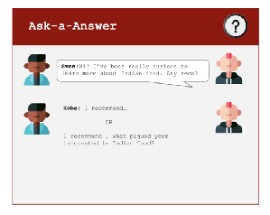
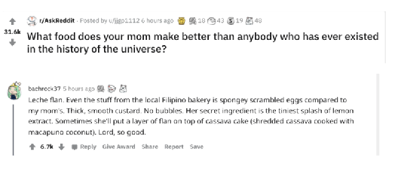
ROLE PLAY
ASK-A-ANSWER
Every response you give ends in a question
COMPARISON WITH REDDIT
Assumption: People enjoy answering questions as a way to connect with others
Assumption: People will want to keep a conversation going, even if the intent was to ask a single question
Notes:
Our experience prototype primarily consisted of a role play. We would ask a question, and then have our interviewee answer and ask a question back. We did this to see their general comfort with the idea of being forced to ask questions.
We then had them compare the idea with online question forums such as reddit.

Slide 39
ANIL
ASK-A-ANSWER
What worked: Asking questions builds build intimate connections
What didn’t work: Many people have knowledge, but some people are closer to the source than others
Surprise: “Google is good for narrowing when researching”, but conversation makes it easier to access other cultures.
New learning: Conversation allows one to see the “effort behind the art”
Software Engineer
Fom India and Guyana
Very extroverted
Notes:
South Asian: sales marketing. Knows a lot about engaging in other conversations. Believes asking people questions is key to understanding them.
Need to explain: effort behind the art, we started talking ab

Slide 40
Assumption: People enjoy answering questions as a way to connect with others
Assumption: People will want to keep a conversation going, even if the intent was to ask a single question
Notes:
Love this slide

Slide 41
New Assumption: People that go online to answer questions won’t feel annoyed since they are opting into the space
Notes:
Love this slide

Slide 42
ASK-A-ANSWER
Every response you give ends in a question
Ask-a-Answer
◾ The need wasn’t as pressing as others identified
◾ People seemed satisfied with other online forums (Reddit)
Kobe:Hi, I’m new to Los Angeles. Where can I find good ramen?
Sven:Heya! Welcome! I really like JINYA ramen, Ramen Hood and Mogu Mogu 🤩
Sven: Also, what brings you to LA?

Slide 43
PROTOTYPE 1: VOICES EVERYWHERE
Make places tell personal stories
HMW make experiences of locals accessible without questions?

Slide 44
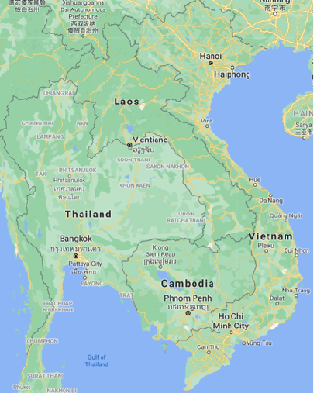
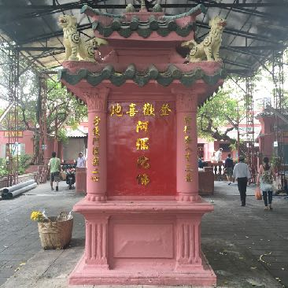
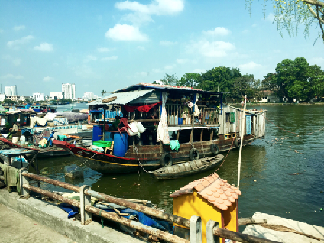
VOICES EVERYWHERE
Make places tell personal stories
Hearing stories from locals about unfamiliar places
Narration of the stories and histories of monuments, buildings and places
Notes:
Premise: the goal is to remove the need to ask questions to local, but still get their experiences. Locals would upload stories about certain locations that they enjoy. When taking a picture of those landmarks or at those locations, you can hear those stories.

Slide 45
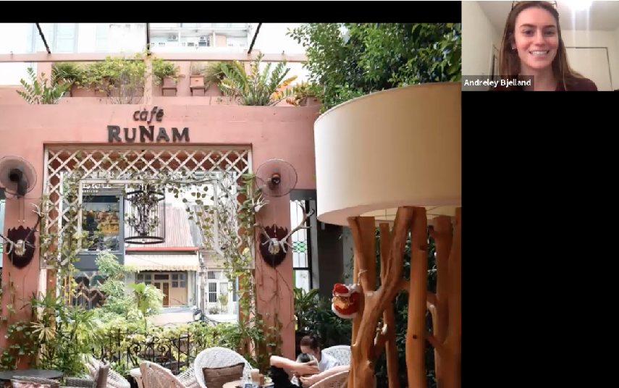
SELF GUIDED TOUR
VOICES EVERYWHERE
Make places tell personal stories
◾ What do participants want to learn more about?
◾ Participants chose whether to get more info
Read a story here
Notes:
Want to see if people are genuinely curious about the nontourist sites that are frequented by locals.

Slide 46
VOICES EVERYWHERE
Make places tell personal stories
Assumption: people will seek more information about buildings and places they are unfamiliar with
Assumption: personal stories will make local sites more attractive to visit

Slide 47
ANDRELEY
VOICES EVERYWHERE
What worked: Personal story made her feel more “personally invested” in her location
What didn’t work: Historical context sometimes felt detached. “If it was a story of a specific soldier” she would stop and read
Tension: Wants to hear from locals, but is scared of language barriers
New learning: When travelling, she doesn’t want to use Google → “the info may not be the most accurate”
PhD Student in Literature at UNC
History buff
Notes:
Andreley has traveled around a lot, but primarily on mission trips or as a tourist. Hasn’t been able to engage with locals because of the separation between those two groups. Felt like she was missing out on a lot of what the country had to offer.

Slide 48
WESLEY
VOICES EVERYWHERE
What worked: Felt connected to the storyteller and shared stories of his own
What didn’t work: Videos without enough contextual info didn’t satisfy curiosity
Surprise: Wants on-demand historical context “right there” in short form text
New learning: Location-dependent preference for general historical context vs. learning via personal stories
San Francisco based
Recruiter at Strava
Avid Tennis Player
Notes:
New learning: For the house boats, Wes wanted to hear a personal story about someone whose lived experience was on the boats vs. the Reunification Palace picture where he wanted more general context about the significance of the Palace with regards to the Vietnam War
Related hearing about someone’s experience at Cafe Runam to his nostalgia from growing up and going to Alice’s near him.

Slide 49
ON CAFE RUNAM
“I want to hear what a local person thinks about it...because it is different for us because we don’t live there”
“I want to hear from a person who has actually gone through it and get their perspective.”
Wesley
ON HOUSEBOATS

Slide 50
Assumption: People will seek more information about buildings and places they are unfamiliar with
Assumption: Personal stories will make local sites more attractive to visit

Slide 51
New Assumption: People most often prefer personal stories compared to general context to learn about places.
Notes:
Love this slide

Slide 52
PROTOTYPE 2: REDEEM THE MEME
Learning culture through memes
HMW make culture of locals accessible without questions?

Slide 53
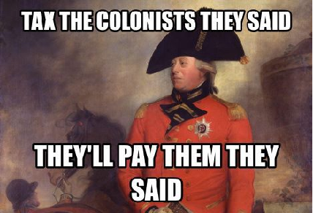
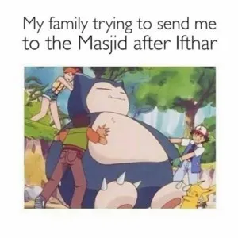
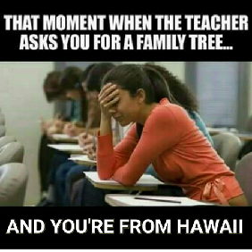
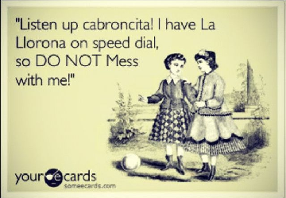
REDEEM THE MEME
Learning culture through memes
Learn about a new culture through a meme
Learn about your own history!

Slide 54
MEME
REDEEM THE MEME
Learning culture through memes
During the holiday Ramadam, Muslims fast every day from dusk to dawn. This means no food or water. At dawn, families will make a large dinner (ifthar) to reward themselves for their hardwork and devotion to the fast. Some families will also go to a masjid (mosque) after eating the feast, however, people eat so much to make up for the fast, that you get that full feeling that people may compare to Thanksgiving.
VS
MEME + CONTEXT
ASSUMPTION: People will seek information about memes they don’t understand
ASSUMPTION: Humor can create a desire to learn more about a culture
Notes:
The format of the experience prototype was simply showing them a series of memes. We wanted to see theyre initial reactions and then context was provided when asked. We then saw how their perception changed once they received the context behind the meme.

Slide 55
ANDRELEY
REDEEM THE MEME
What worked: Didn’t brush off memes she didn’t understand, asked questions to understand humor
What didn’t work: “it can be reductive, you see a little glimpse without other context”
Surprise: Found memes entertaining even if she couldn’t relate → saw connections to her own culture
New learning: Felt more comfortable knowing the identity of creator
PhD Student in Literature at UNC
History buff

Slide 56
ASANTE
REDEEM THE MEME
What worked: Would ask even more questions about context to see if he fully understands
What didn’t work: Fearful of perpetuating stereotypes out of ignorance
Insight: “I want to be in on the joke. I know it’s supposed to be funny”
New learning: “I would send these to my friends, but only if they didn’t need the context”
Certified Nurse
Lover of Tik Tok
Interested in learning about boyfriend’s culture

Slide 57
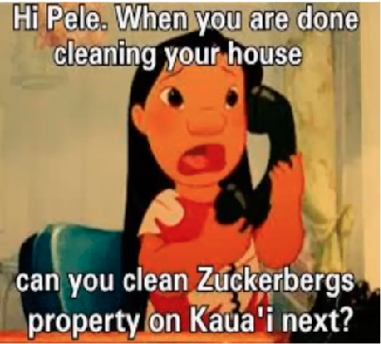
“There is sometimes a danger in using humor and it allows people to just kind of sweep the underlying issues aside.”
Andreley
Notes:
Here Andreley is concerned that although the meme is funnt, it still is hitting a hot topic of gentrification of Hawaii and how the indigenous people have been exploited for decades. The humor still does allow people to access this darker part of the history that we are part of, but still may undermine it.

Slide 58
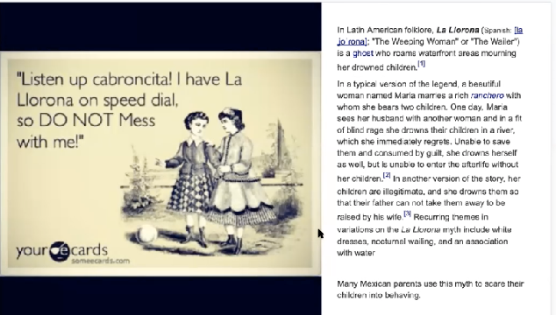
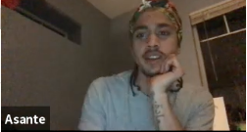
“I just want enough information for the meme, and then if I want, I can go learn more about that information”
Asante
Notes:
Emphasize that sometimes historical context can feel overwhelming. Need to start with pieces and encourage people to branch off from there.

Slide 59
Assumption: People will see memes as a valid source of info
Assumption: Memes can still sensitively introduce culture
Assumption: Humor can create a desire to learn more about a culture

Slide 60
New Assumption: People value memes more as culture learning tools when they know the creator’s identity
Notes:
Love this slide

Slide 61
PROTOTYPE 3: E-TICKET
Creating a culturally relevant performance
HMW we use context and background to excite audiences?

Slide 62
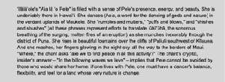
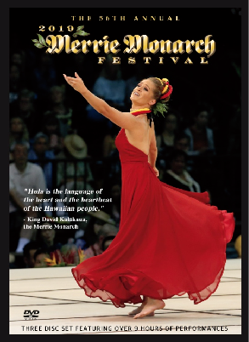
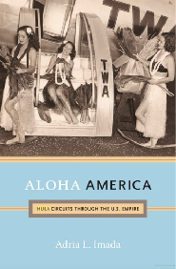
E-TICKET
Creating a culturally relevant performance
https://www.youtube.com/watch?v=-NhPqimnr3o
Engagement with content as a requisite for attendance
Engage with relevant content before attending a performance to learn cultural and historical context
Videos removed so this ppt file is less ginormous
https://www.youtube.com/watch?v=BFT-M18N2A4

Slide 63
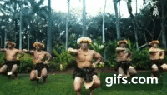
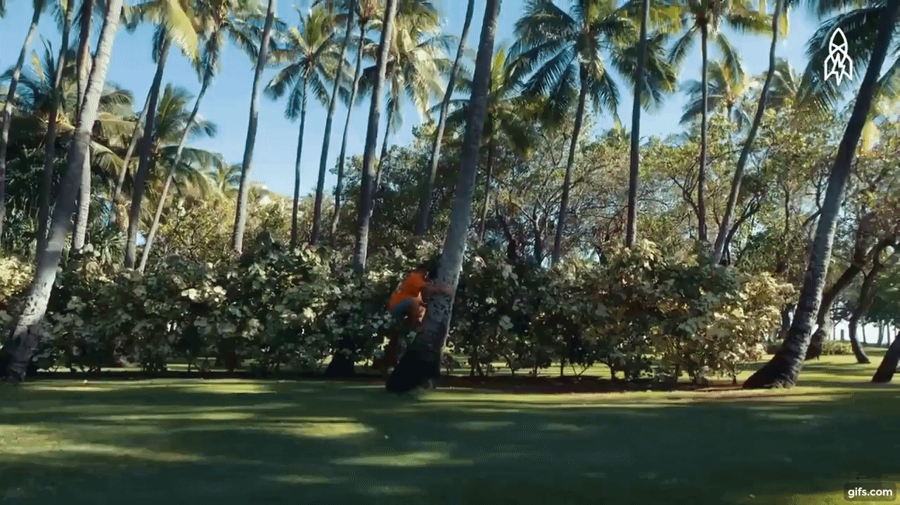
E-TICKET
Creating a culturally relevant performance
ROLE PLAY
User chooses content or skips to performance
Ex. Historical Context of Hula
Ex. Videos/Pictures of how performers train
Notes:
Can also read about the background of a specific song

Slide 64
E-TICKET
Creating a culturally relevant performance
Description of a song included in performance
Assumption: People will exert effort to prepare for a cultural performance if resources are provided
Assumption: Seeing the effort put into a performance makes people more appreciative of the performance
Notes:
Can also read about the background of a specific song

Slide 65
GUS
E-TICKET
What worked: challenged his stereotypes → realized hula isn’t just a beautiful dance and is more inclusive of gender
What didn’t work: Doesn’t want to feel forced to watch video prior to performance
Surprise: Changed his perception of hula to be more inclusive of gender
New learning: Wouldn’t want to actively seek info. “If a friend told me to, I would”
Would opt in to education if readily available
Student at UMich studying Linguistics and Spanish
Avid videogamer
Notes:
Would opt in to education if it were readily avaialble

Slide 66
WILSON
E-TICKET
What worked: Seeing the training opened his eyes to how difficult hula is, “not just an easy thing my dad did in Hawaii”
What didn’t work: Blurbs of information are exhausting and inaccessible with cultural vocab
Surprise: Wants to do historical research prior to buying the ticket.
New learning: When waiting in a seat for a performance to start, he’s dependent on his pamphlet to kill time.
Informatics B.S. at USC
Used to play in orchestra

Slide 67
KAREN
E-TICKET
What worked: “Appreciated hearing about significant it is not just to the dancers but to everyone they are representing”
What didn’t work: Feels “intrusive” after seeing the connection people have to the art - “I don’t know if I belong here”
Surprise: Started to tear up when seeing the passion of the dancers
New learning: Instinct is to be on her phone when waiting for performances
Psych major at Stanford
Loves to attend cultural events at Stanford with friends
Notes:
Karen lost a sense of belonging after watching the video - need balance

Slide 68
Assumption: People will exert effort to prepare for a cultural performance
Assumption: Seeing the hard work and significance of the performance for an individual makes viewers more appreciative of the art.

Slide 69
New Assumption: Digital forms of engagement are more effective than paper/pamphlets
New Assumption: People will exert effort to learn about the performance when they are bored

Slide 70
04
SOLUTION AND SUMMARY

Slide 71
KEY LEARNINGS
Viewers are invigorated by seeing the hard work and passion that people put into their art
Personal stories inspire people to look deeper into the culture and history of sites
Humor is an accessible way of introducing someone to culture
Notes:
Love this slide

Slide 72
KEY LEARNINGS
No matter the problem or solution we look at:
Personal stories are at the heart of cultural understanding
Notes:
Love this slide

Slide 73
NEXT STEPS
01
Finalizing which problem we want to address
02
Modifying our solutions
03
Concept video!
Notes:
Love this slide

Slide 74
05
APPENDIX

Slide 75
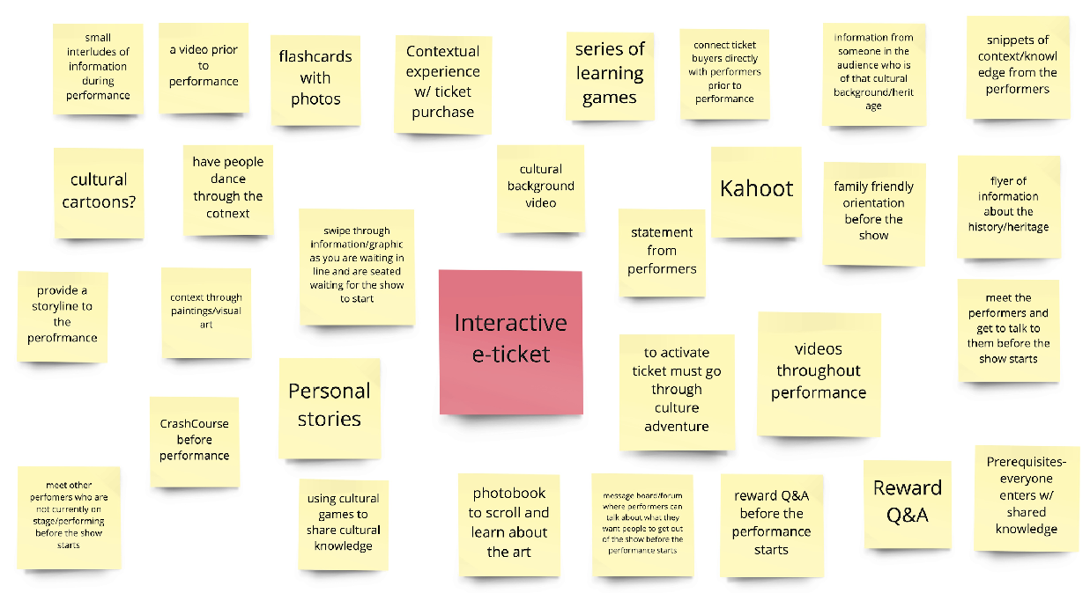
HMW USE CULTURAL CONTEXT TO ENHANCE PERFORMANCE?

Slide 76
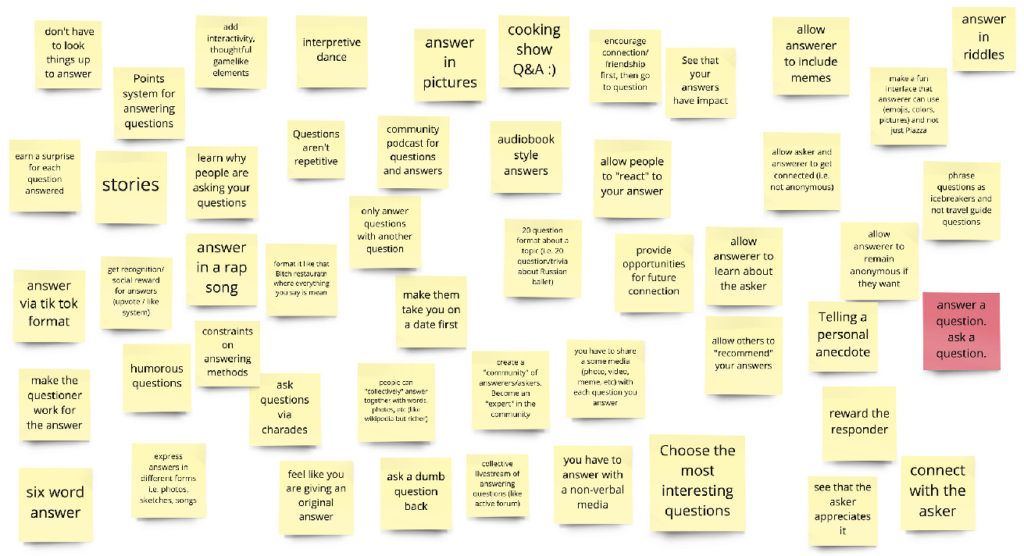
HMW ENCOURAGE CONVERSATIONS BETWEEN PEOPLE OF DIFFERENT BACKGROUNDS

Slide 77
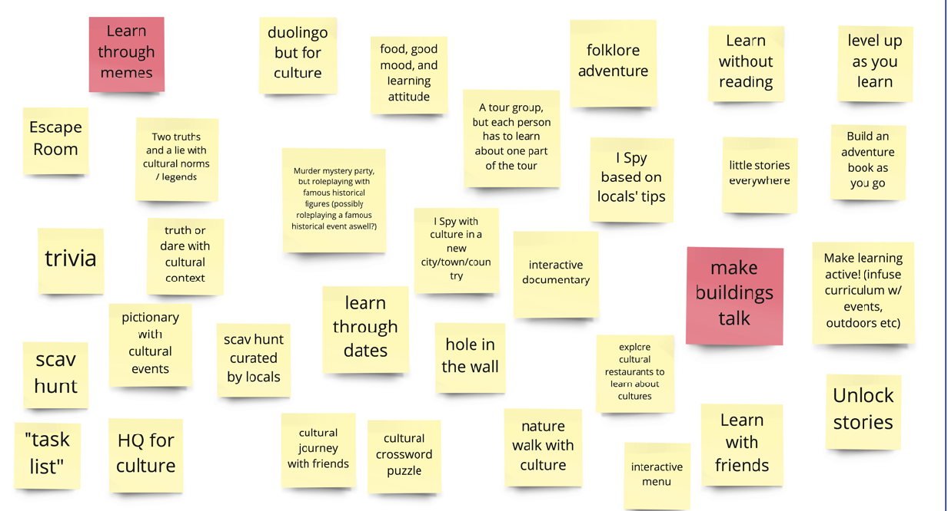
HMW MAKE CULTURAL LEARNING AN ADVENTURE?

