Slide 1
NEEDFINDING
Taylor Lallas, Krishnan Nair, Baker Sharp, Ayelet Drazen
Studio: Arts & Culture

Slide 2
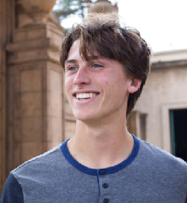
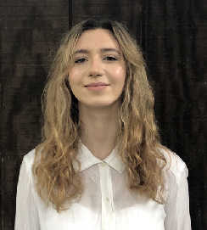
OUR TEAM
Taylor Lallas
B.A. Economics
M.S. Computer Science
Krishnan Nair
B.S. Computer Science
Baker Sharp
B.S.. Computer Science
Ayelet Drazen
B.A. Political Science
M.S. Computer Science
Problem domain: exploring the relationship between one’s personal network and artistic tastes

Slide 3
OVERVIEW
01
NEEDFINDING METHODOLOGY
02
INTERVIEW RESULTS
03
04
ANALYSIS
SUMMARY

Slide 4
01
NEEDFINDING METHODOLOGY

Slide 5
Interview Guide
Interviews
Empathy Maps
Analysis
Brainstorm

Slide 6
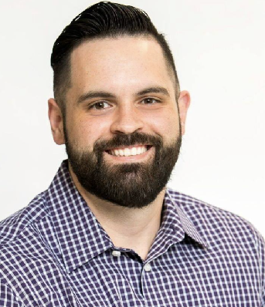
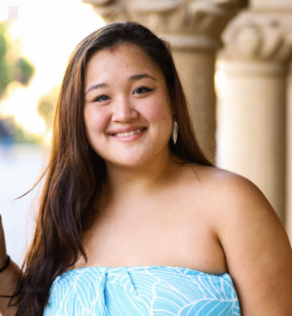
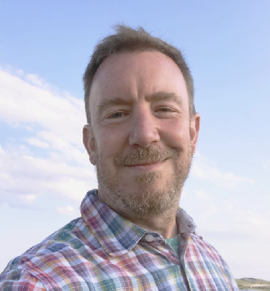
Our Interviewees:
Marco
Nadin
Kawena
Justin
Michelle
Jerry
Polina
Junryl
Marisa
Notes:
We interviewed nine people over the past week. Our goal was to truly get an array of perspectives that could lay out how people with different backgrounds interact with art and how their personal networks play in. This of course is dependent on the type of network they have access to.
We looked at different types of users and people with different sizes of social circles.
Extreme users can be identified by those who are activley involved in media (podcast) or those who don’t engage in media at all.
Extreme users can also be identified by the social networks. Those with large audiences that they connect with compared to those who only connect with a few regarding art.

Slide 7
Picking our Interviewees:
Age Diversity
Gender Diversity
Occupational Diversity
Background Diversity
Extreme Users
Average Users

Slide 8
What we Asked:
Can you tell me about content you love that is a guilty pleasure?
Do you keep track of art you love? How?
Do you use social media to share music? Why or why not?
What is the biggest barrier you face in sharing your content?
What art moves you? Why?
You want to find a new podcast. Where do you look?
How would you invite someone into your culture using art?
Tell me about a time you got a recommendation. How did you feel?
And of course . . . pulling threads and following up on emotions and stories!

Slide 9
02
INTERVIEW RESULTS

Slide 10
MARCO
◾ Mortgage underwriter and pro-wrestler
◾ “Knows Spotify better than his email”
◾ Active in the LGBT community
◾ East Bay native
User Type:
Notes:
Why did we choose him? Jerry recommended him. Also turned out to be a great candidate because he showed how arts/culture intertwines with the LGBTQ community.

Slide 11
MARCO
“In real life, that’s who you are going to see on social media. There is not really a differentiation between Marco and Marco-Mania [wrestling name].”
User Type:

Slide 12
JERRY
◾ Teaches computer science at Stanford
◾ Foodie, musician, news junkie, and traveller
◾ Most passionate about music and piano, especially classical music
User Type:

Slide 13
JERRY
“I like the idea of supporting the arts and I able to trust this particular effort because of my friend.”
“I’m not trying to be condescending, it’s just time consuming to go through [donation] emails from people you don’t know.”
User Type:
Notes:
A lot of our discussion with Jerry revolved around philanthropy, which we will be discussing further on in this presentation.

Slide 14
JUSTIN
◾ Process engineer at Ancon industrial services
◾ Doesn’t consider himself an artist
◾ Enjoys being introduced to art by friends, doesn’t seek it on his own
◾ Consumer
User Type:
Notes:
Just is one of our extreme users who represents a nonuser-nonartist. He does consume media, but doesn’t actively seek it.

Slide 15
JUSTIN
”But the things I find more meaningful for sure... It's definitely within those peer groups… I don’t know if it's like a weird trusting or they just know what I like.”
User Type:
Notes:
Conversation revolved around the meanings behind recommendations. How poeple feel closer when you send a personal recommendation rather than simply posting it on facebook. Also talked about how he would bring other people to musical theratre with him to share his love for the art and they would go because they’re close to him.

Slide 16
KAWENA
◾ Case manager at Waikiki Health in Oahu
◾ Hula dancer
◾ Former president of Kaorihiva (Stanford’s polynesian dance group)
◾ Japanese/Hawaiian
User Type:
Notes:
Chosen because she is both a consumer and producer of art. Also could talk about minority cultures and how art plays a role in indigineity.

Slide 17
KAWENA
“For us, arts isn’t a way for us to show what we know, but to preserve it and also share it with you and each other.”
“A big part of [the disconnect] is the playing up of stereotypes”
User Type:
Notes:
Conversation revolved around how art is intertwined with cultural identity and perception.

Slide 18
MARISA
◾ Senior at Stanford University
◾ Competitive Hula Dancer
◾ Filipino/Chinese
◾ Current president of Kaorihiva
◾ Creator and Consumer
User Type:
Notes:
I wouldn’t say that Marisa is on the low end of the user scale lol. She uses media pretty often. I would say shes average
Marisa gives the contrasting perspective to Kawena. She did not grow up Hawaiian, so she immersed herself in a culture that she isn’t associated with by blood. Had to navigate ways to solidify her position within the community.

Slide 19
MARISA
“I try to give as much context as possible in a way that is still accessible because to dance in isolation, without the cultural context is kind of disrespecting the cultural context for me.
User Type:
Notes:
I wouldn’t say that Marisa is on the low end of the user scale lol. She uses media pretty often. I would say shes average
Marisa gives the contrasting perspective to Kawena. She did not grow up Hawaiian, so she immersed herself in a culture that she isn’t associated with by blood. Had to navigate ways to solidify her position within the community.
Conversation explored the ways that she reconnected with a Hawaiian identity through hula, even though she is not Hawaiian by blood. Also talks about the challenges she faces in breaking down stereotypes of Hawaiian artists.

Slide 20
POLINA
◾ Olympic figure skater
◾ Podcast host for Bleav Network
◾ Artist with a “mindset of iron”
◾ Fiction fanatic, music lover
◾ Creator and consumer
User Type:

Slide 21
POLINA
"commentators are borderline disrespectful a lot of the time"
"you talk to a reporter, and they pick what they want to frame you as"
User Type:
Notes:
Polina is an extreme user as both an avid producer and user. She actively engages with a large audience-base. This conversation led to stories about the barriers of figure skating and toxic culture that competitive arts may produce.

Slide 22
NADIN
◾ Enjoys spices and flavors and experiencing new cultures
◾ Has a deep appreciation for theater
◾ Elderly (over 70)
User Type:

Slide 23
NADIN
“The ‘umami’ of plays is the context... where are you, who are you with?”
“
User Type:

Slide 24
MICHELLE
◾ Art student at WashU
◾ Architecture & interior design buff, MICHELLEV leather goods
◾ Pinterest is her artistic inspiration archive
◾ Creator and consumer
User Type:

Slide 25
MICHELLE
”I think arts very personal. So I think that when people are sharing that with you or like recommending you music or art or whatever, like you get to know them a little better, which is awesome.”
User Type:
Notes:
Surprised that she didn’t want to share her art with a bigger audience. Was ok with it being a personal thing.

Slide 26
JUNRYL
◾ Create hair colorist based in SF
◾ Moved to LA to become a singer/songwriter
◾ Struggles to gain a following for his singing
◾ Creator and consumer
User Type:

Slide 27
JUNRYL
“It's funny because as a musician, I should be listening to a lot of music but I'm very bad at listening to music.”
“People want instant gratification, because you’re just moving so fast. I feel like even if a video [on Instagram] is 40 seconds, that’s too long.
User Type:

Slide 28
03
ANALYSIS

Slide 29
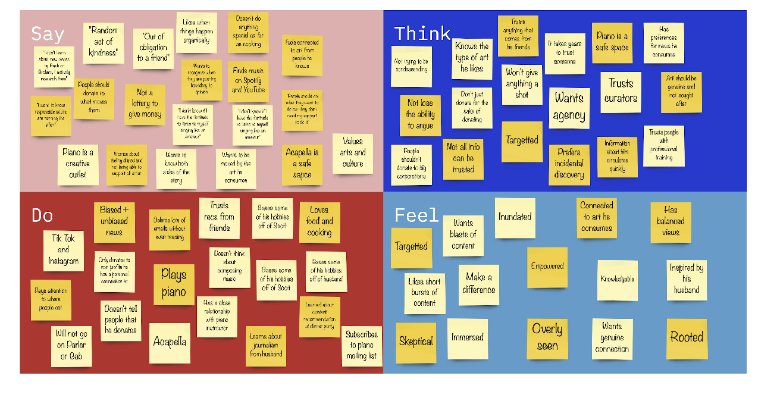
JERRY

Slide 30
SAY
JERRY
THINK
Philanthropy as “random act of kindness
People should donate to what moves them
“It happened organically as opposed to intentionally”
Not all information can be trusted; will only trust his friends
DO
FEEL
Deletes lots of donation emails without even reading
Only donates to organizations he has a personal connection to
Wants blasts of information
Agency
Targetted

Slide 31
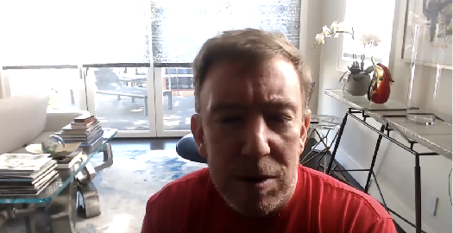
TENSION
“I read the email out of obligation to a friend”
ANALYSIS
CONTRADICTION
Only wants to donate to organizations he knows yet considered donating to a talented 18 year old from New Orleans who he has never met

Slide 32
INSIGHT
People have a personal attachment to their money and donations
NEED
A way for donors to see the impact of their philanthropy in the arts on a personal level

Slide 33
ANALYSIS
CONTRADICTION/SURPRISE
Feels like content can arise “out of a void”
Relies on Tik Tok and Instagram algorithms to consume music

Slide 34
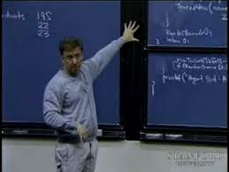
ANALYSIS
INSIGHT
Social media algorithms take away the enjoyment of art exploration
NEED
A way to connect people to the navigation of new artistic content in a personal manner.

Slide 35
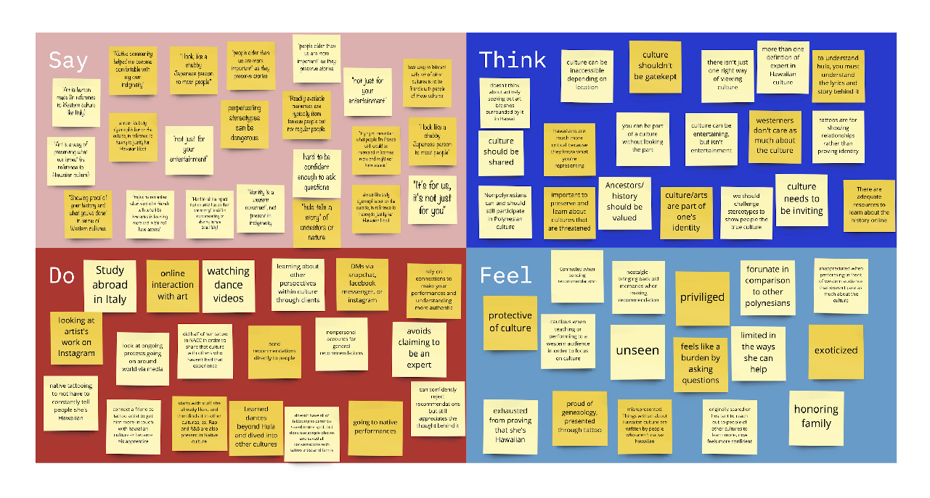
KAWENA

Slide 36
SAY
KAWENA
THINK
“[Hula] is not just for your entertainment”
People from outside of culture aren’t easily engaged with history behind the art
“Hard to be confident enough to ask questions”
People judge your culture based on looks rather than practice
DO
FEEL
Sends personal recommendation to people directly
Got a Polynesian tattoo of her genealogy in the NACC at Stanford
Burdening
Exoticized
Unseen
Stereotyped
Notes:
Say: “art is a way of showing what we know”, “it’s for us, it’s just for you”, “[hula] is not just for your entertainment”
Think: culture shouldn’t be gatekept, culture should be shared, westerners don’t care as much about Hawaiian culture
Do: connect her friends with native artists that they may like, got a Hawaiian tattoo of geneaology to honor family and show other’s shes Hawaiian
Feel: Exhausted from having to tell people she’s Hawaiian, burdening for asking questions, protective of culture, exoticized, prideful, underappreciated

Slide 37
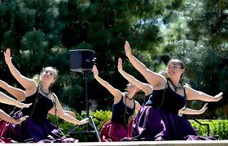
ANALYSIS
Tension/Contradiction
“[Hula] is not just for your entertainment”
Performs in front of Western audiences
Notes:
Tension: it ca be intimidating to ask questions
Needs: a way for people to reconnect with culture that they may feel removed from
Contradiction: Believes that you should listen to the Hawaiian elders and masters for guidance in culture, but feels that famous elders dominate the space for people to share culture.

Slide 38
ANALYSIS
INSIGHT
Cultural art is exoticized according to the eye of the beholder, cultural significance is easily lost
NEEDS
A way for others to engage with the history/significance of the art without feeling disconnected or bored.
“It’s for us, it’s not just for you”
Notes:
Tension: it ca be intimidating to ask questions
Needs: a way for people to reconnect with culture that they may feel removed from
Contradiction: Believes that you should listen to the Hawaiian elders and masters for guidance in culture, but feels that famous elders dominate the space for people to share culture.

Slide 39
ANALYSIS
SURPRISE
Willing to get a tattoo of her genealogy in front of her peers
“I am fortunate that I grew up in Hawaii”
Notes:
Tension: it ca be intimidating to ask questions
Needs: a way for people to reconnect with culture that they may feel removed from
Contradiction: Believes that you should listen to the Hawaiian elders and masters for guidance in culture, but feels that famous elders dominate the space for people to share culture.

Slide 40
ANALYSIS
INSIGHT
There is a desire to share cultural art to those who have been isolated from that part of their identity.
NEED
Greater access to cultural art for minorities who do not have a strong cultural community.
Notes:
Tension: it ca be intimidating to ask questions
Needs: a way for people to reconnect with culture that they may feel removed from
Contradiction: Believes that you should listen to the Hawaiian elders and masters for guidance in culture, but feels that famous elders dominate the space for people to share culture.

Slide 41
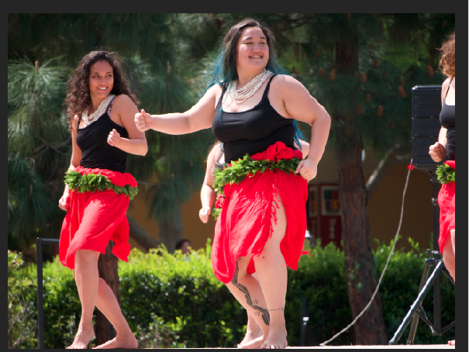
ANALYSIS
Contradiction/Tension
Cultural info is abundant on internet but “dominated by a few” figures
“Need to respect our elders”
Notes:
Tension: it ca be intimidating to ask questions
Needs: a way for people to reconnect with culture that they may feel removed from
Contradiction: Believes that you should listen to the Hawaiian elders and masters for guidance in culture, but feels that famous elders dominate the space for people to share culture.

Slide 42
ANALYSIS
INSIGHT
The knowledge of younger generation and budding artists is undermined.
NEED
Ways to empower and connect younger people who are interested in sharing and learning about cultural art.
Notes:
Tension: it ca be intimidating to ask questions
Needs: a way for people to reconnect with culture that they may feel removed from
Contradiction: Believes that you should listen to the Hawaiian elders and masters for guidance in culture, but feels that famous elders dominate the space for people to share culture.

Slide 43
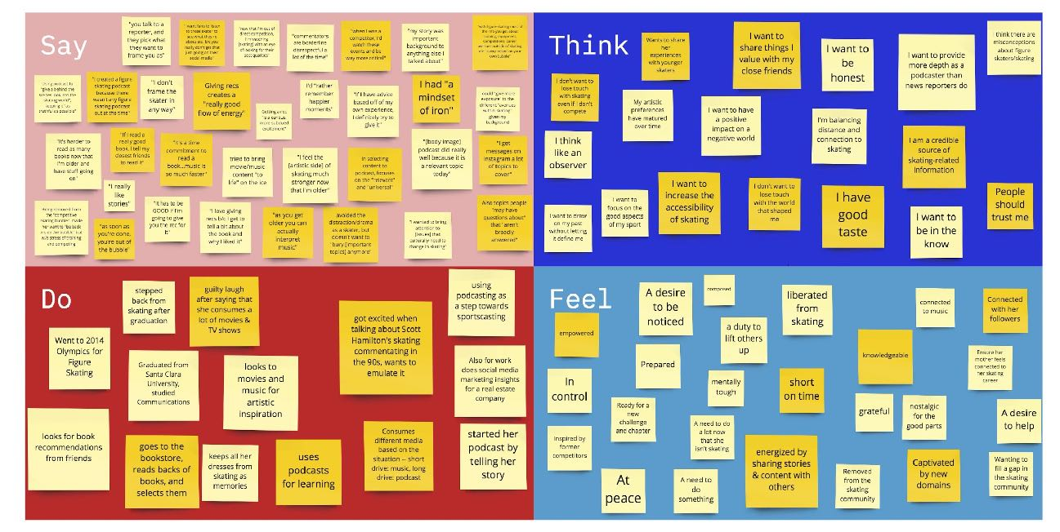
POLINA

Slide 44
SAY
POLINA
THINK
Uses podcast to illuminate “issues that culturally need to change in skating”
The skating community should be more honest and accessible
Giving recs creates a “really good flow of energy”
Wants to draw on her past without letting it define her
DO
FEEL
Brings positivity to an overly-critical artistic bubble
Liberated expert, seeking ways to create impact
Sharing content and stories with friends & fans is energizing
Looks to movies, music & fiction for artistic inspiration

Slide 45
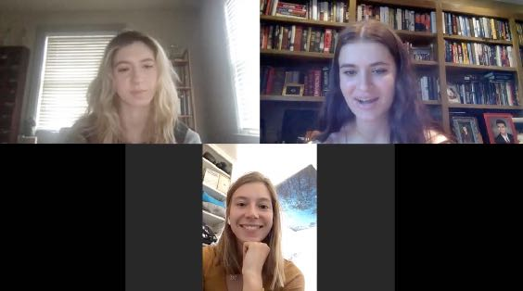
ANALYSIS
CONTRADICTION
“Selectively remembers the happier moments”, but seeks candid conversation about the negatives
TENSION
Outside the “bubble,” but still wants in

Slide 46
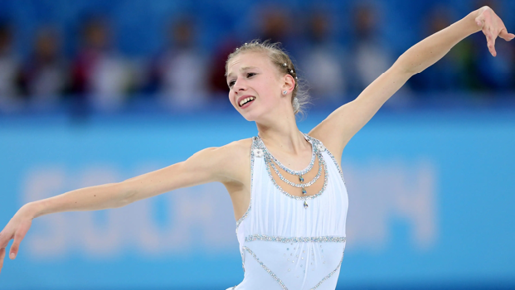
ANALYSIS
INSIGHT
The criticism of competitive art forms can create a toxic environment for budding artists
NEED
Bring transparency, positivity, and change to skating culture

Slide 47
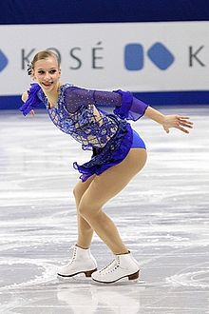
ANALYSIS
SURPRISE
In 2020, she created the first ever podcast dedicated to figure skating
Tension
Access to competitive arts like figure skating are restricted by income
Notes:
Tension: it ca be intimidating to ask questions
Needs: a way for people to reconnect with culture that they may feel removed from
Contradiction: Believes that you should listen to the Hawaiian elders and masters for guidance in culture, but feels that famous elders dominate the space for people to share culture.

Slide 48
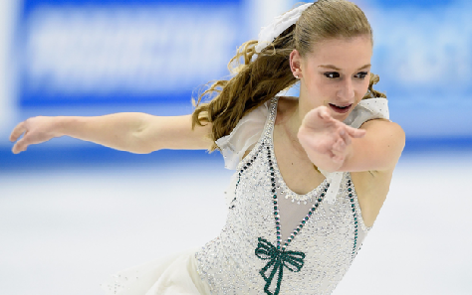
ANALYSIS
INSIGHT
The skating world is insular, inaccessible. Expert coaches & training groups keep info close to the chest
NEED
Making current, trusted information about skating accessible
Notes:
Tension: it ca be intimidating to ask questions
Needs: a way for people to reconnect with culture that they may feel removed from
Contradiction: Believes that you should listen to the Hawaiian elders and masters for guidance in culture, but feels that famous elders dominate the space for people to share culture.

Slide 49
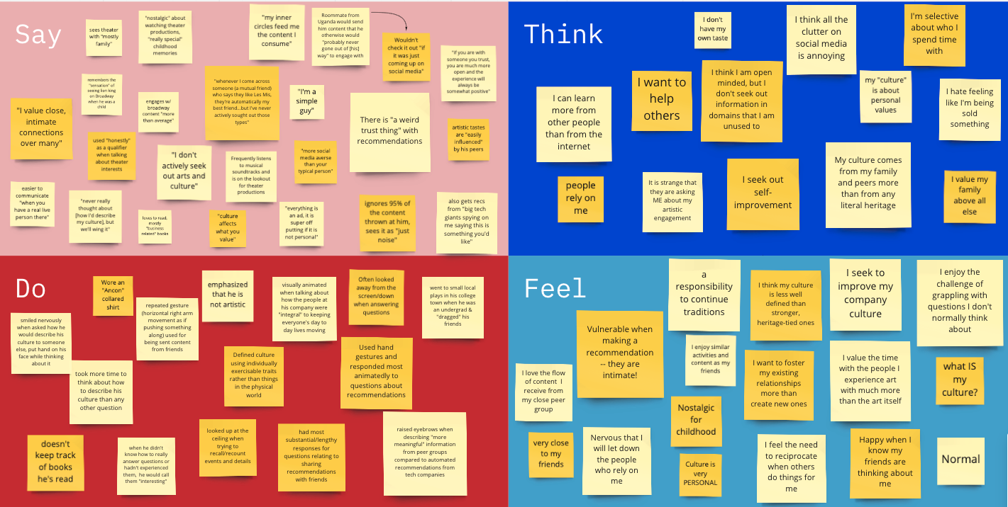
JUSTIN

Slide 50
SAY
JUSTIN
THINK
“I value close intimate connections over many.”
"Everything is an ad, it is super off putting if it is not personal"
Can learn more from other people than the internet
Hate feeling like he’s being sold something
DO
FEEL
Dragging friends to local plays while in college
Smiled nervously when asked how he would describe his culture
Vulnerable when making recommendations
Confused about what culture means to him

Slide 51
04
SUMMARY

Slide 52
SUMMARY
01
Everyone wants to have a connection to the art they consume and interact with.
02
Generally speaking, people are more likely to trust recommendations from their friends.
Some people feel a tension between contributing and engaging with an artistic community while still feeling as if the connection is their own.
03

